Slide 1
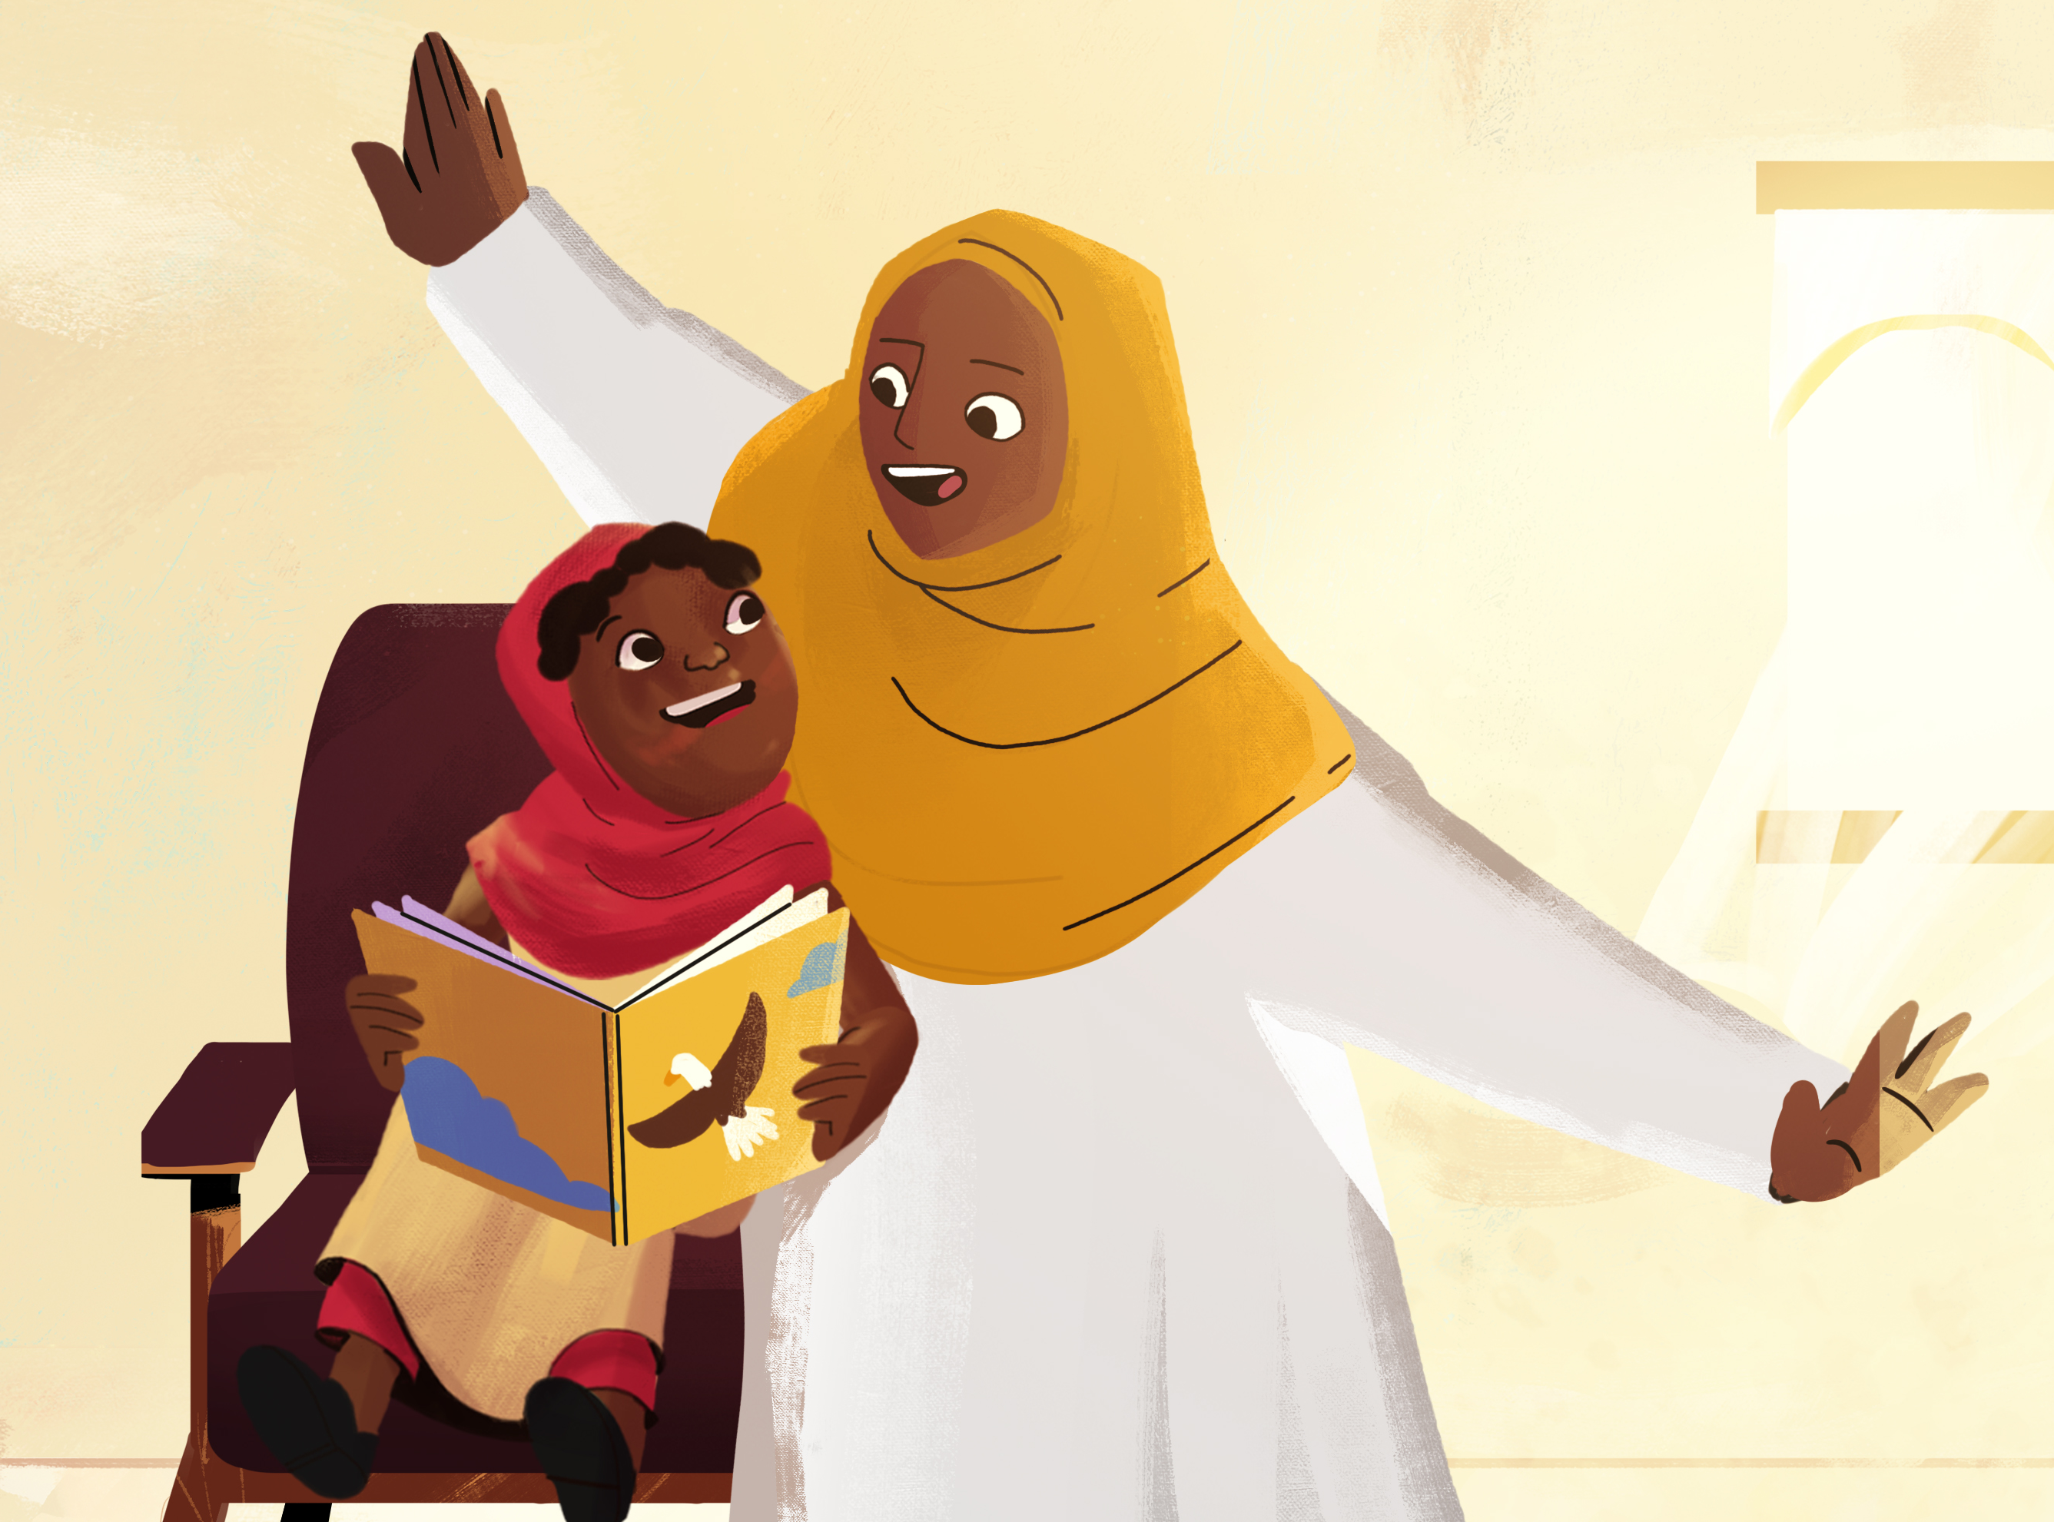
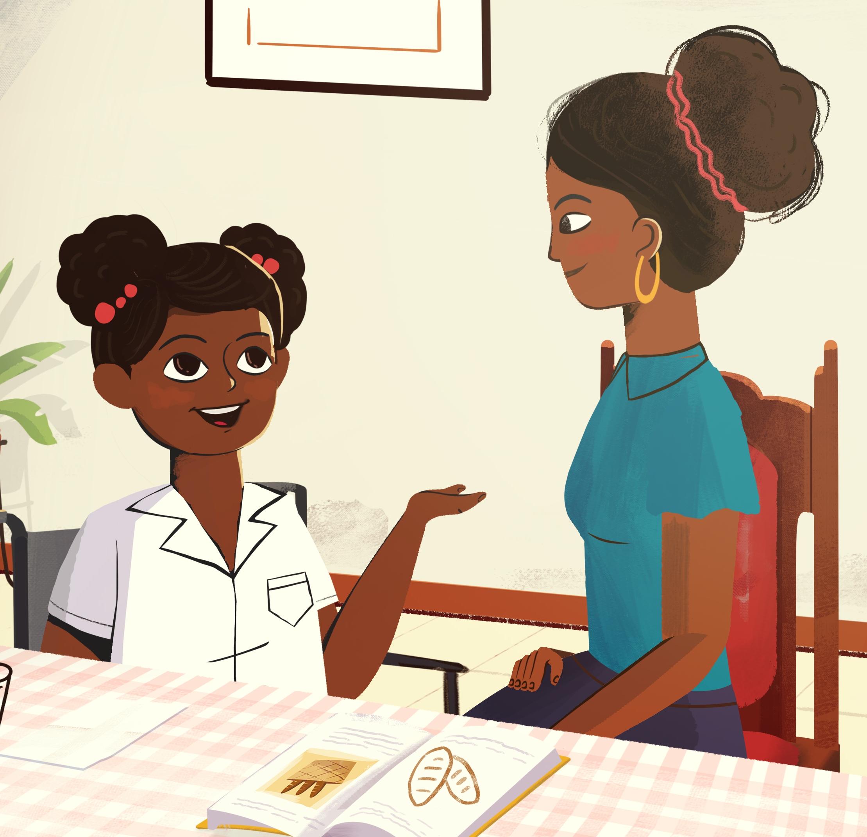
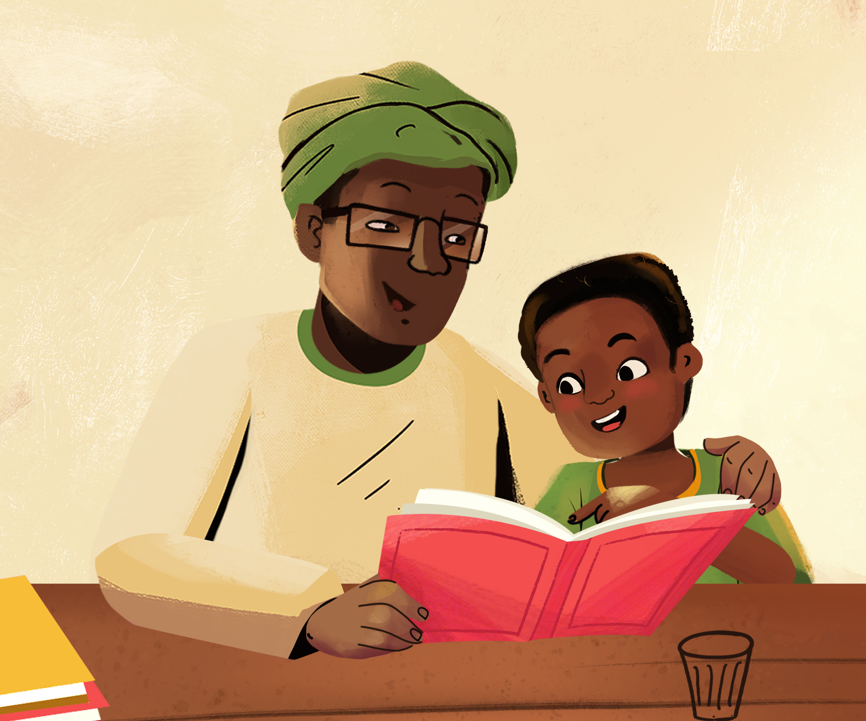
All caregivers can help children with reading!
Even if you can’t read yourself, talk to children about the pictures and ask them questions about the story.

