Slide 1
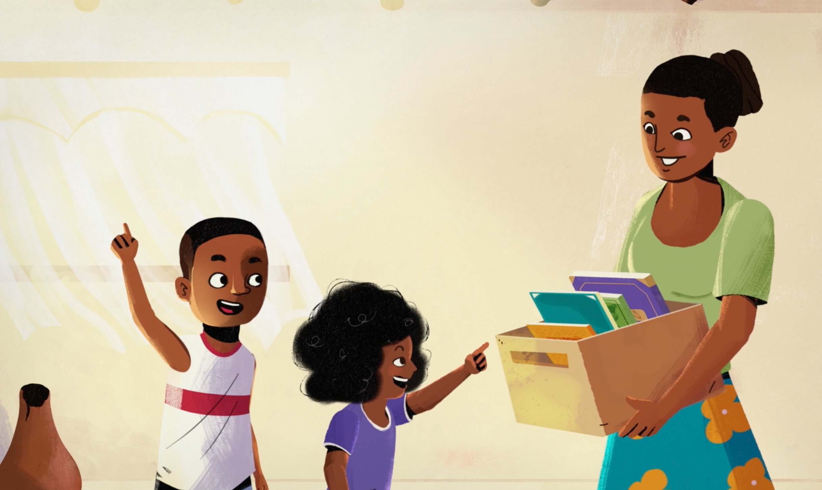
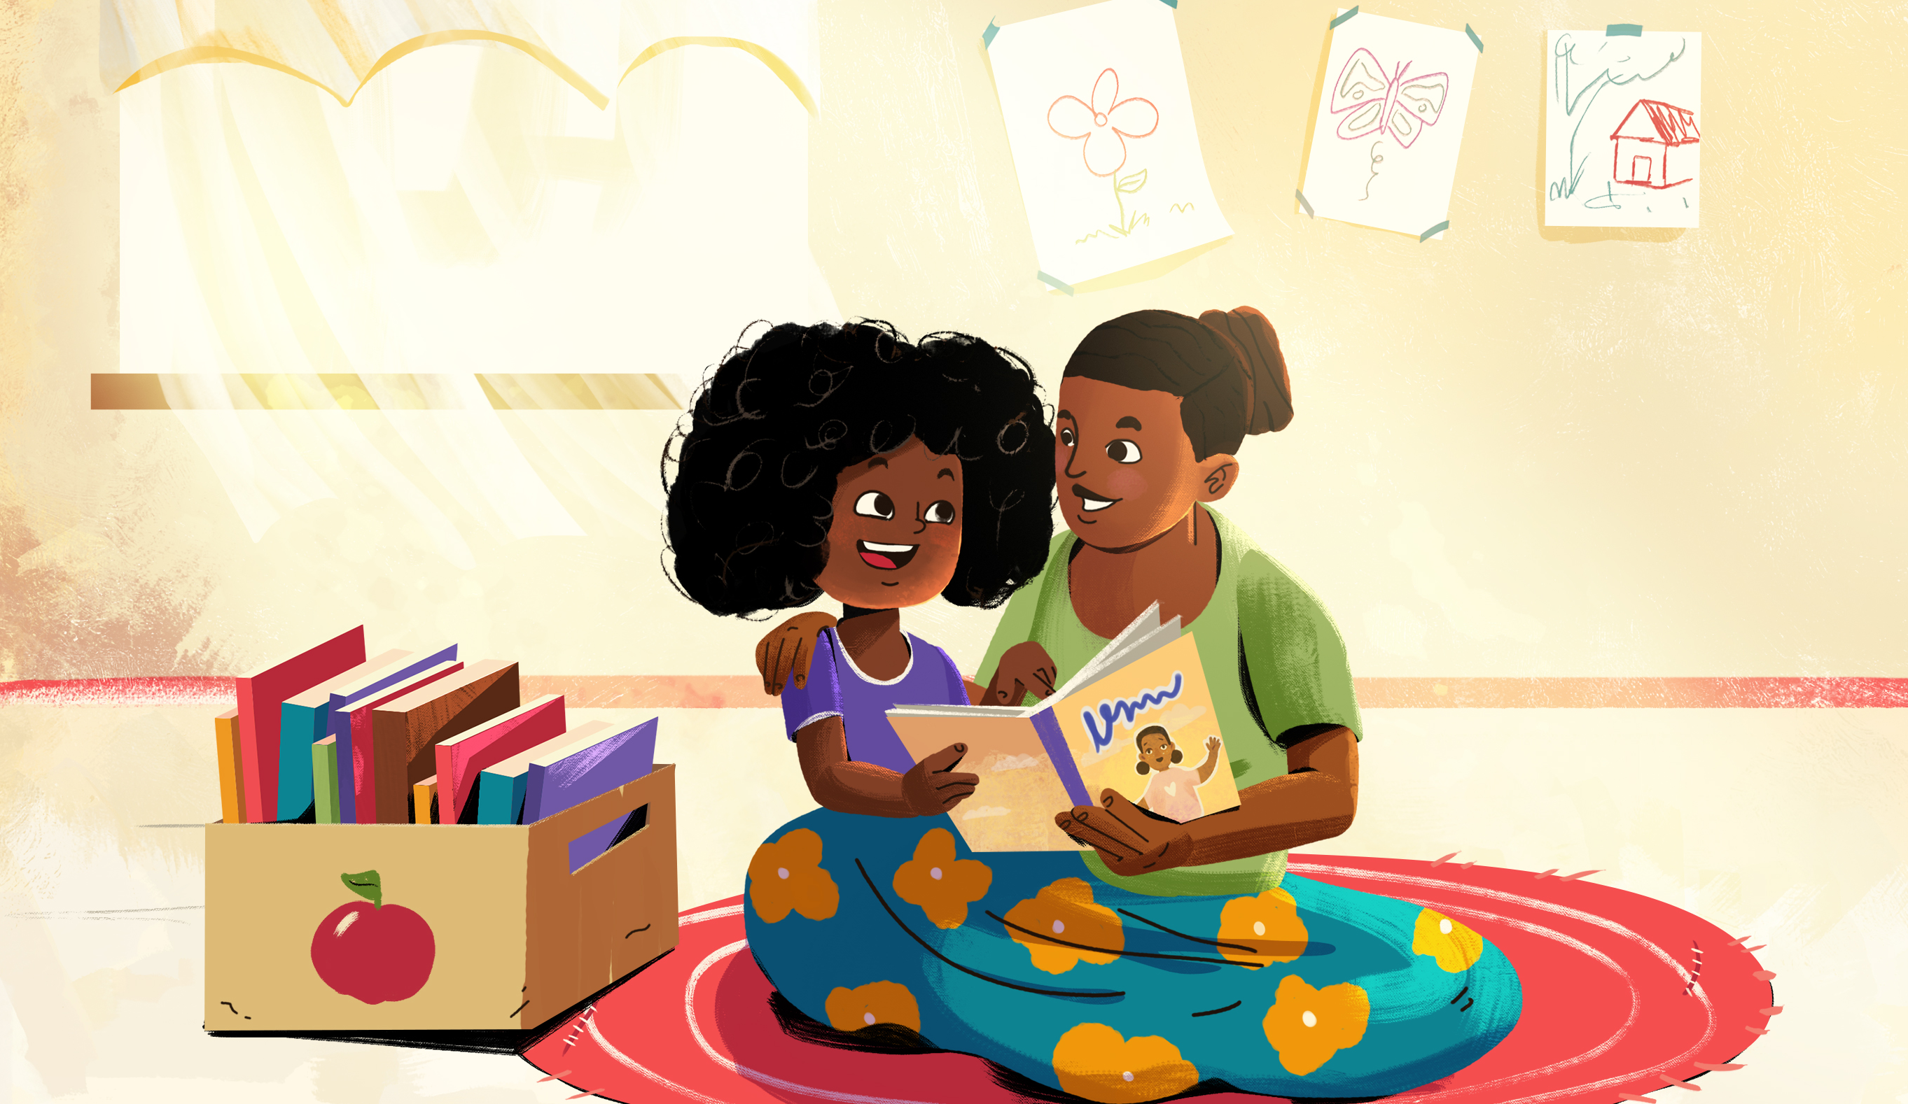
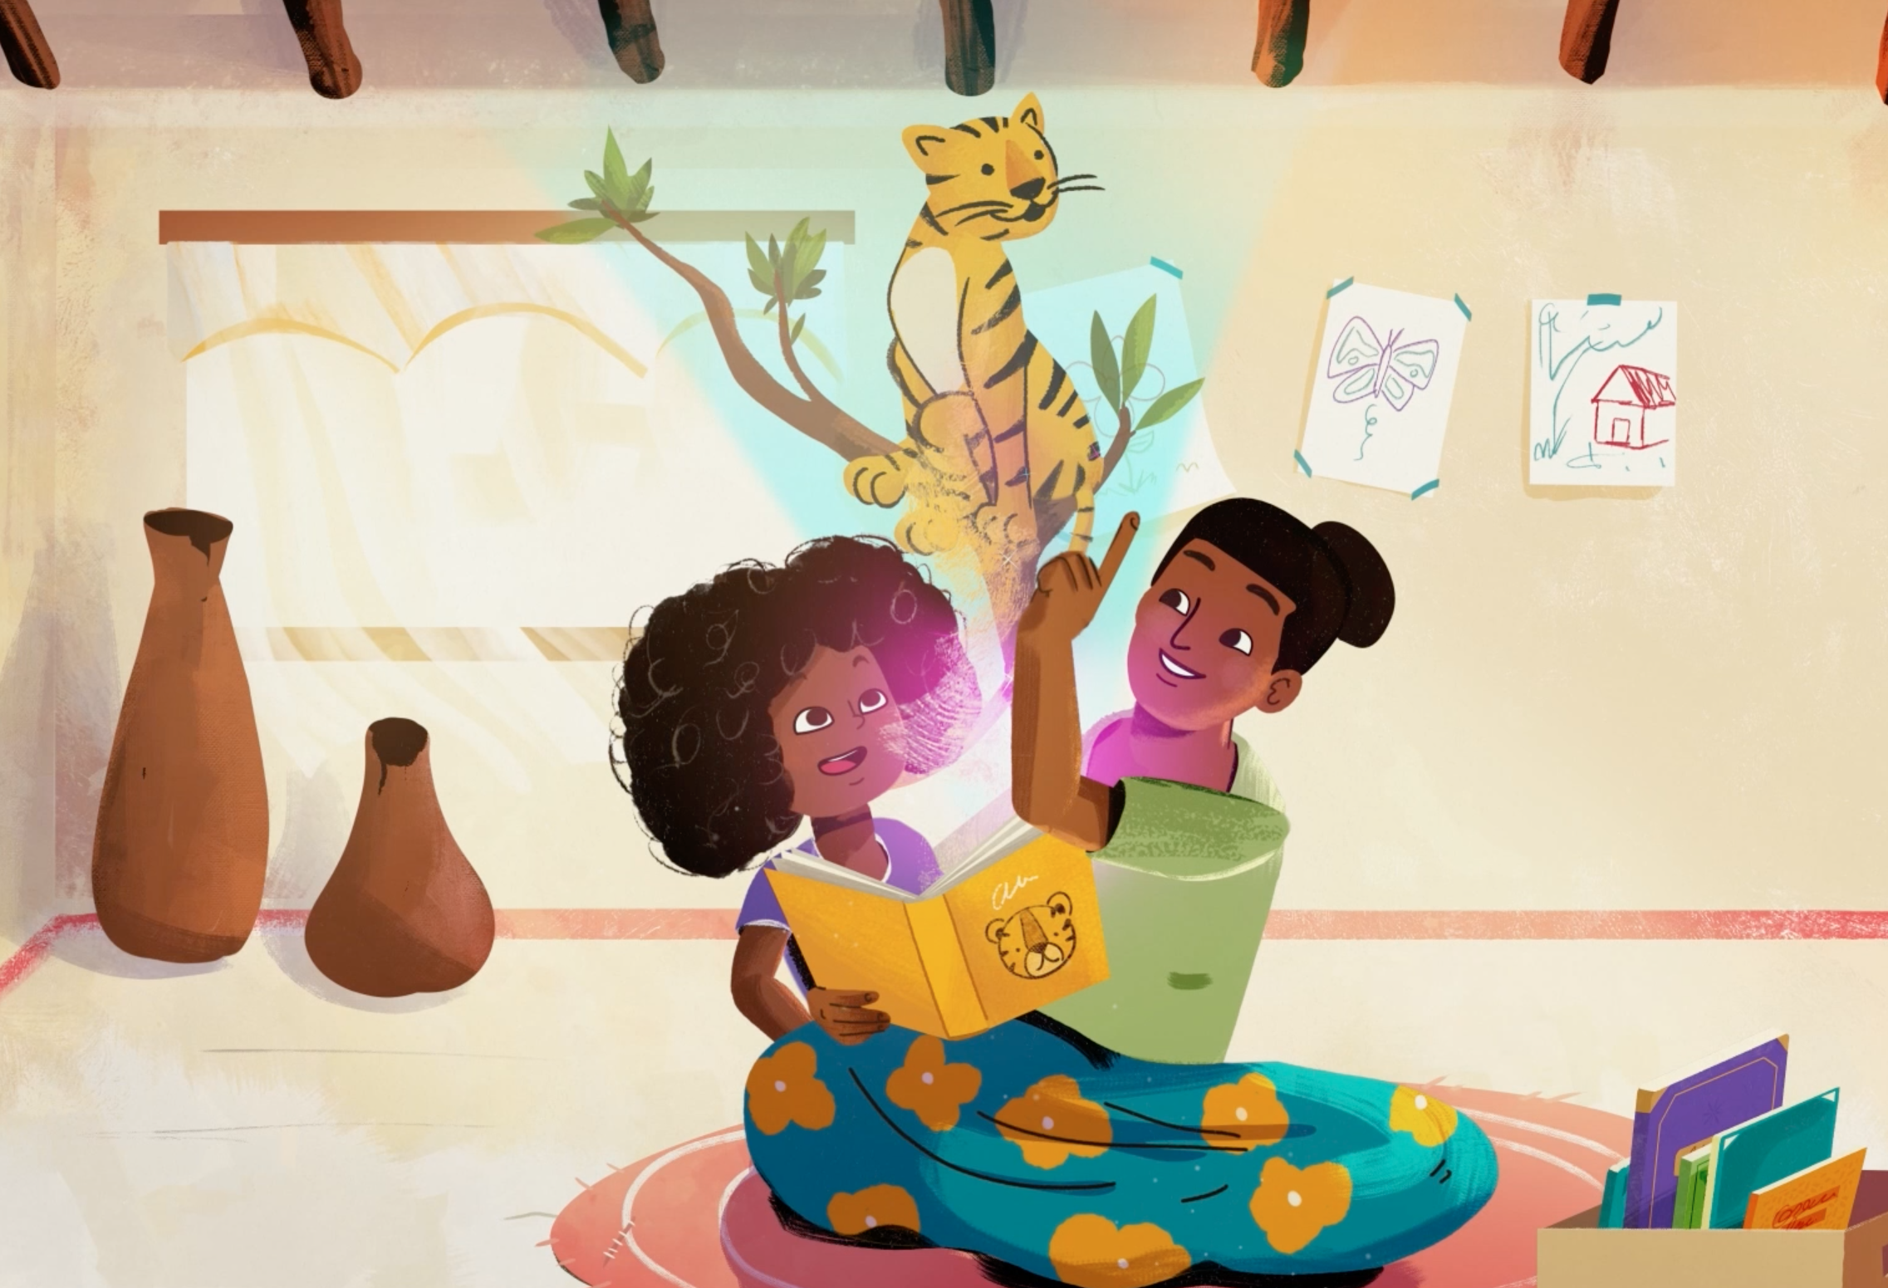
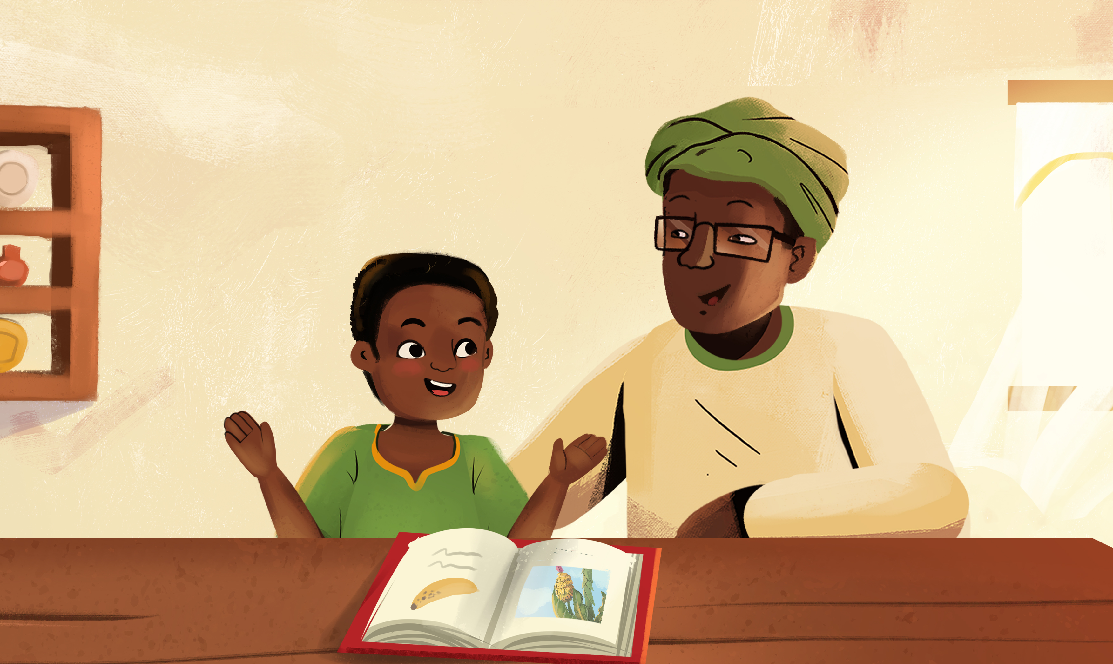
All caregivers can help children with reading!
Before the Story:
Make time for reading every day
Find a comfortable place to sit
During the Story:
Use the pictures to tell the story
Mimic sounds and actions
Ask questions about the story
Praise your child’s efforts!
After the Story:
Ask your child to re-tell the story
Draw pictures or write sentences from the story

