Slide 1
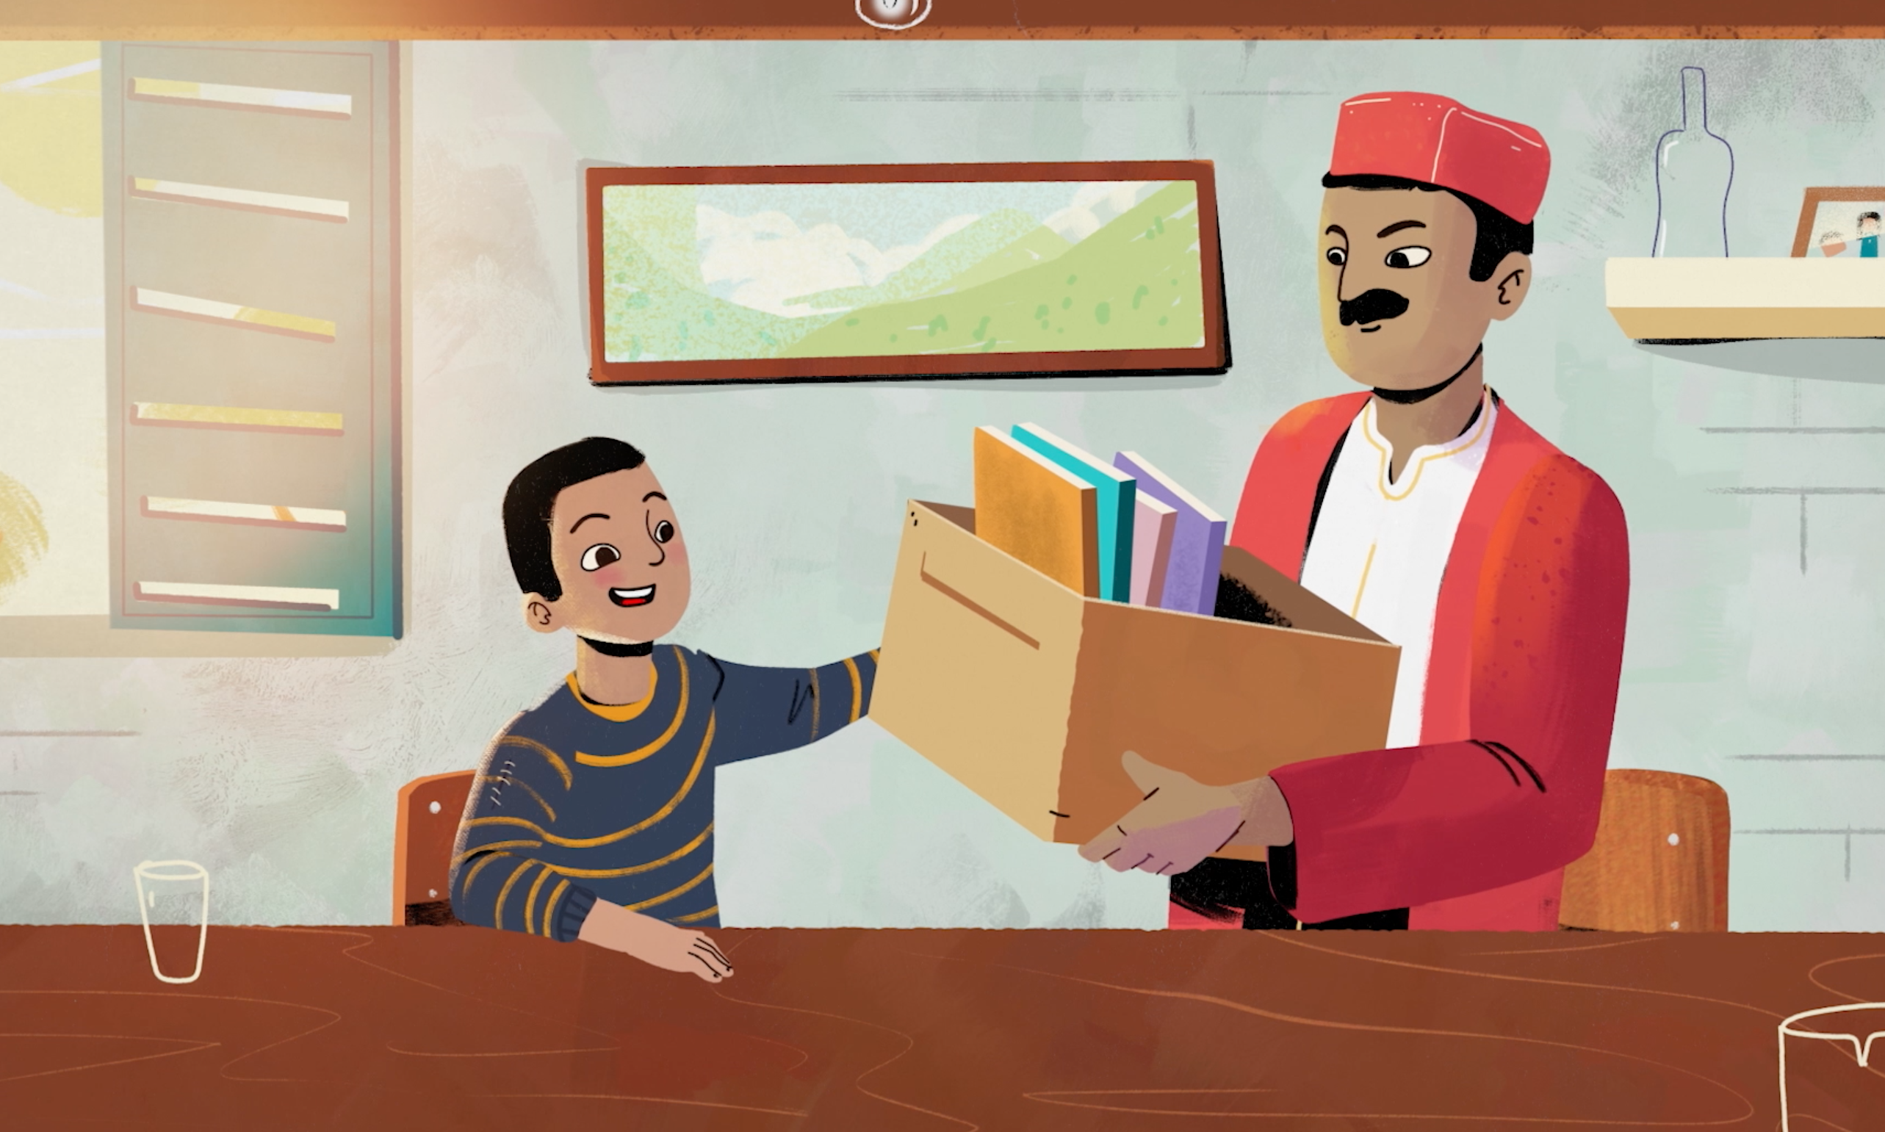
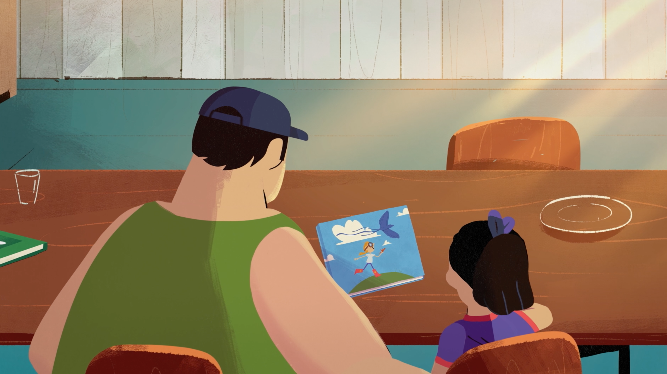
BEFORE THE STORY
Make a space at home for reading
Make reading part of your daily routine
Find a comfortable way to sit together
Discuss the book’s cover

Slide 2
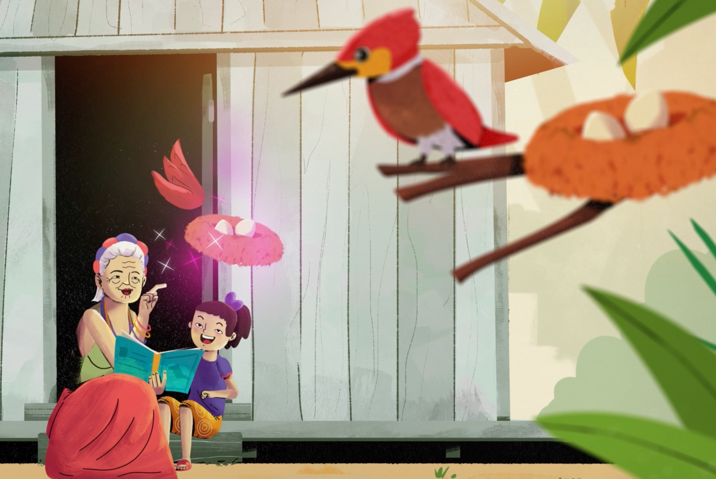
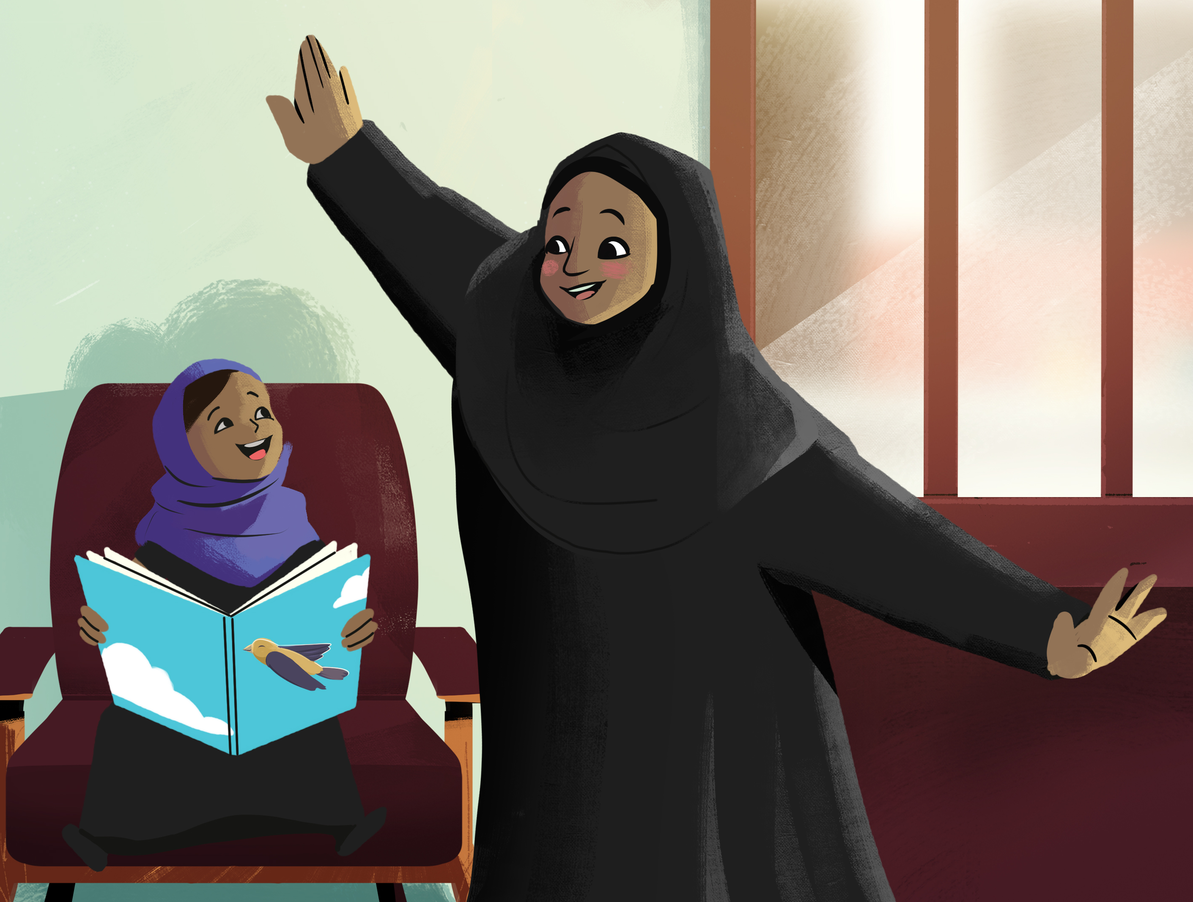
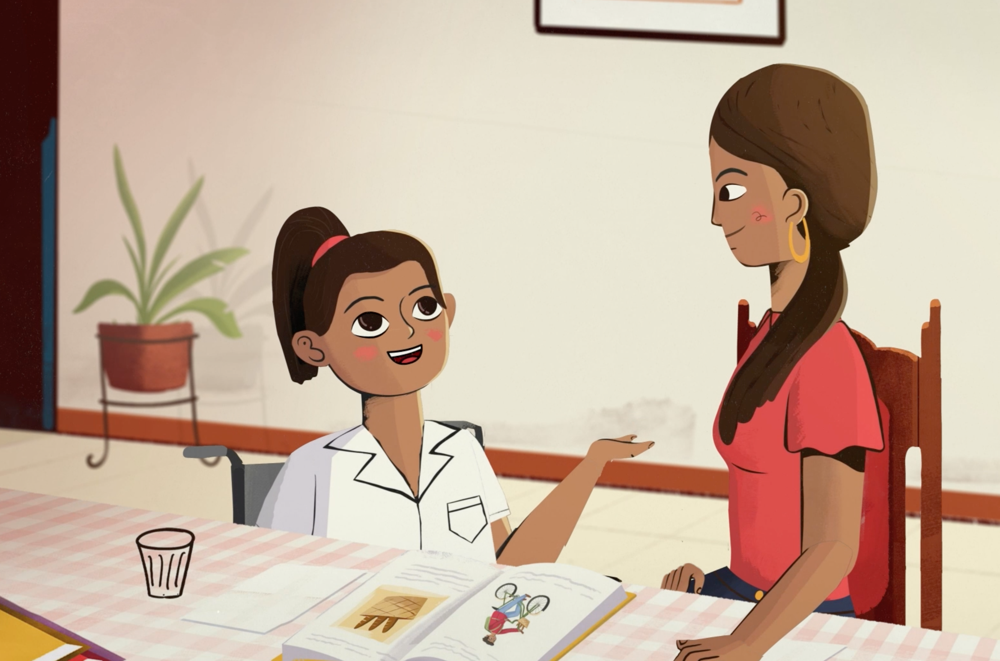
DURING THE STORY
Use the pictures to describe the story
Mimic sounds and actions from the story
Ask your child questions about the story
Praise your child’s efforts!

Slide 3
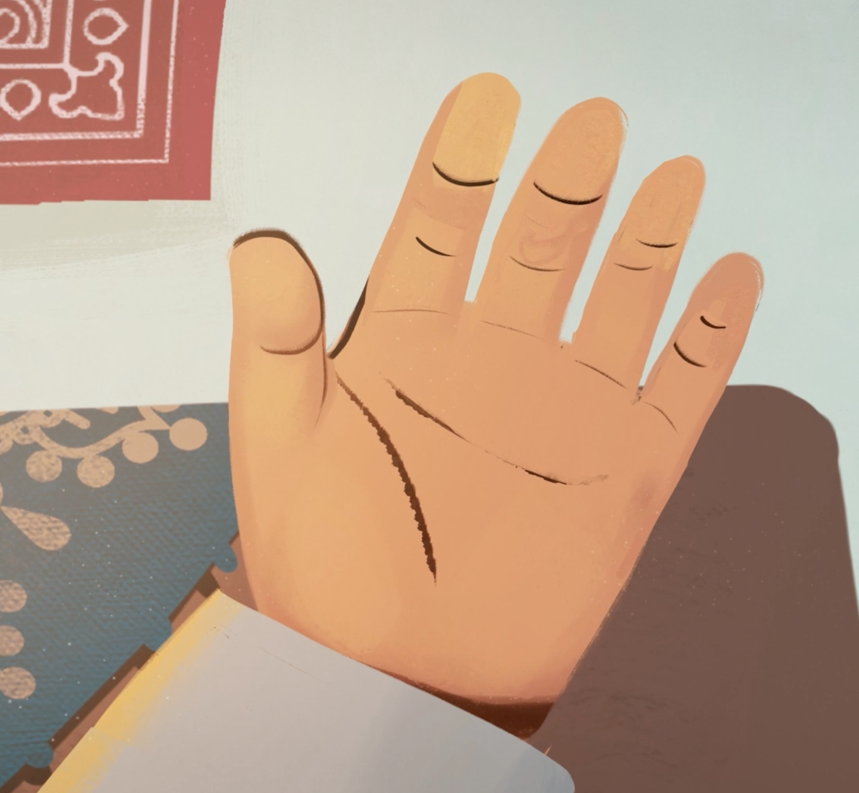
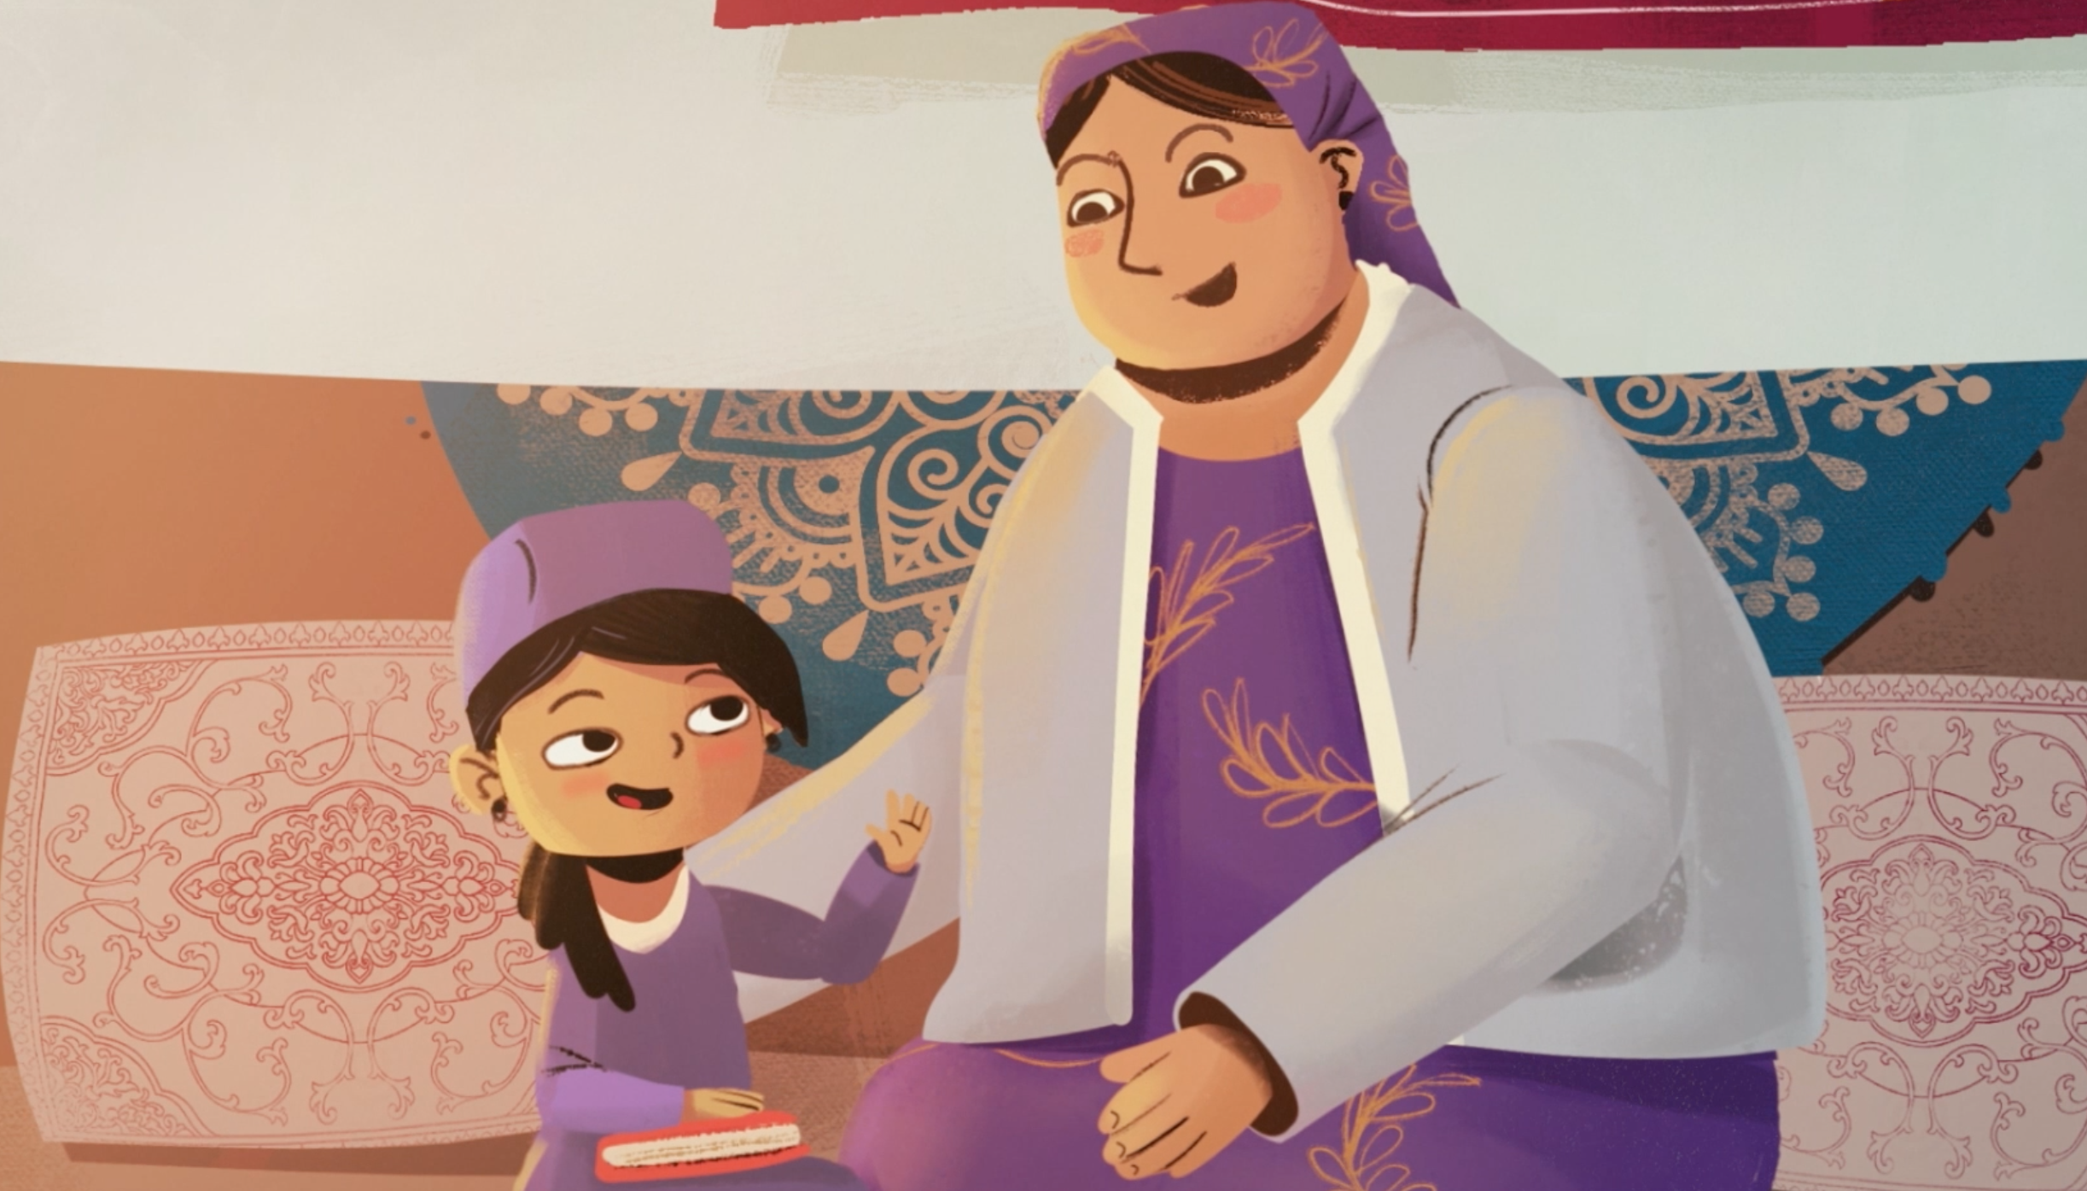
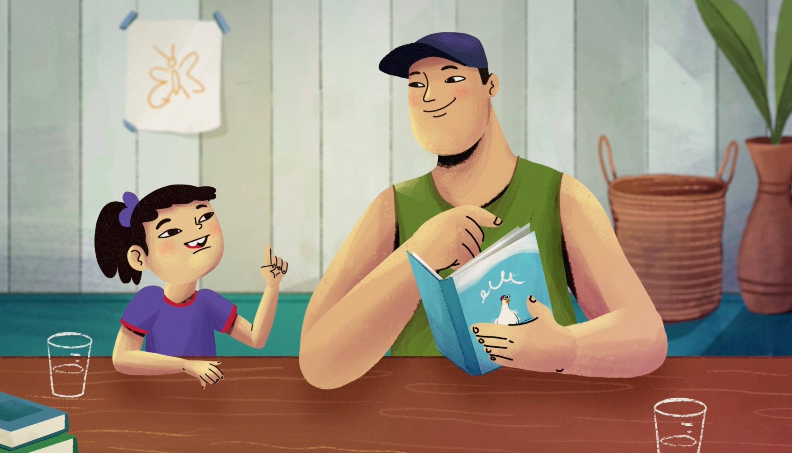
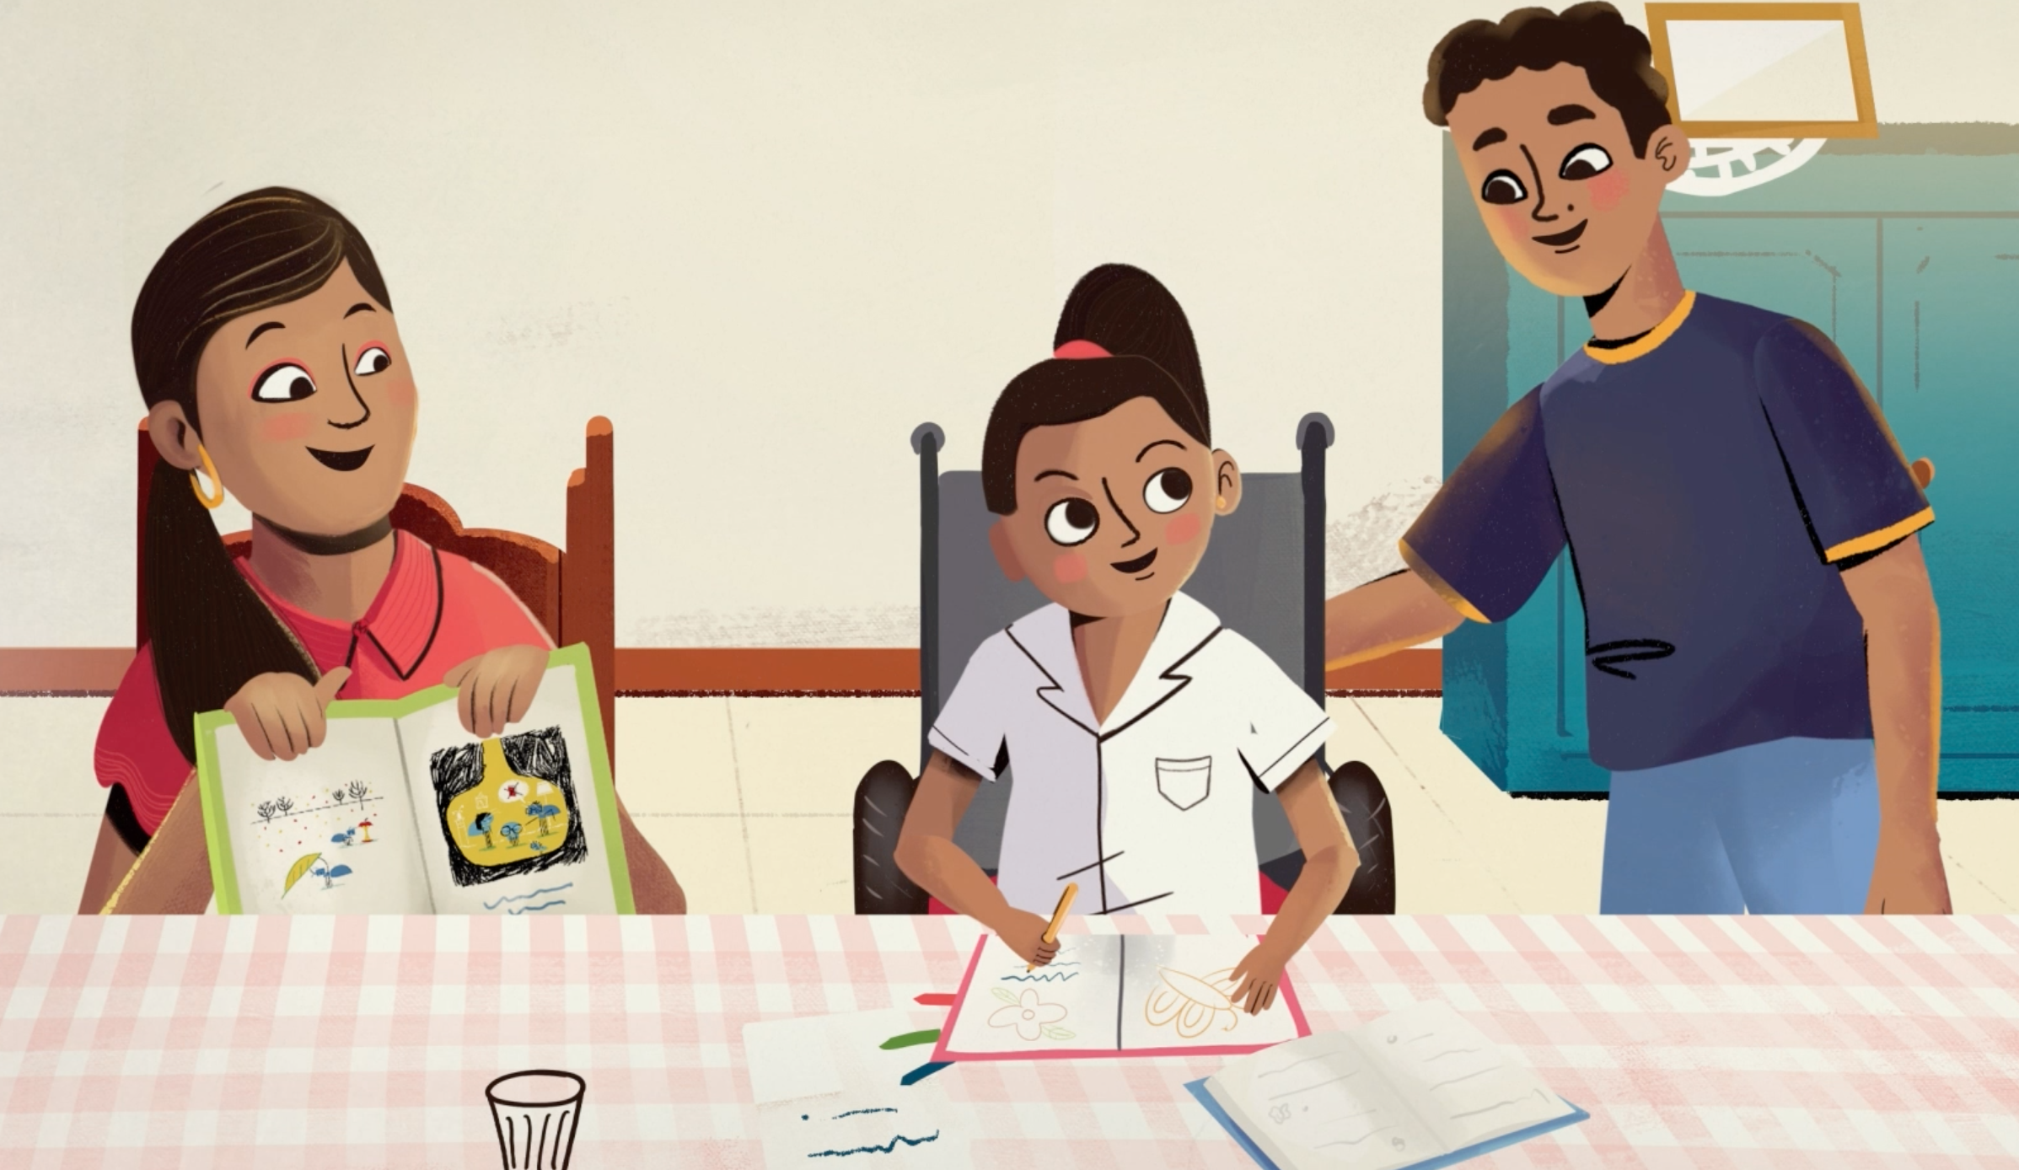
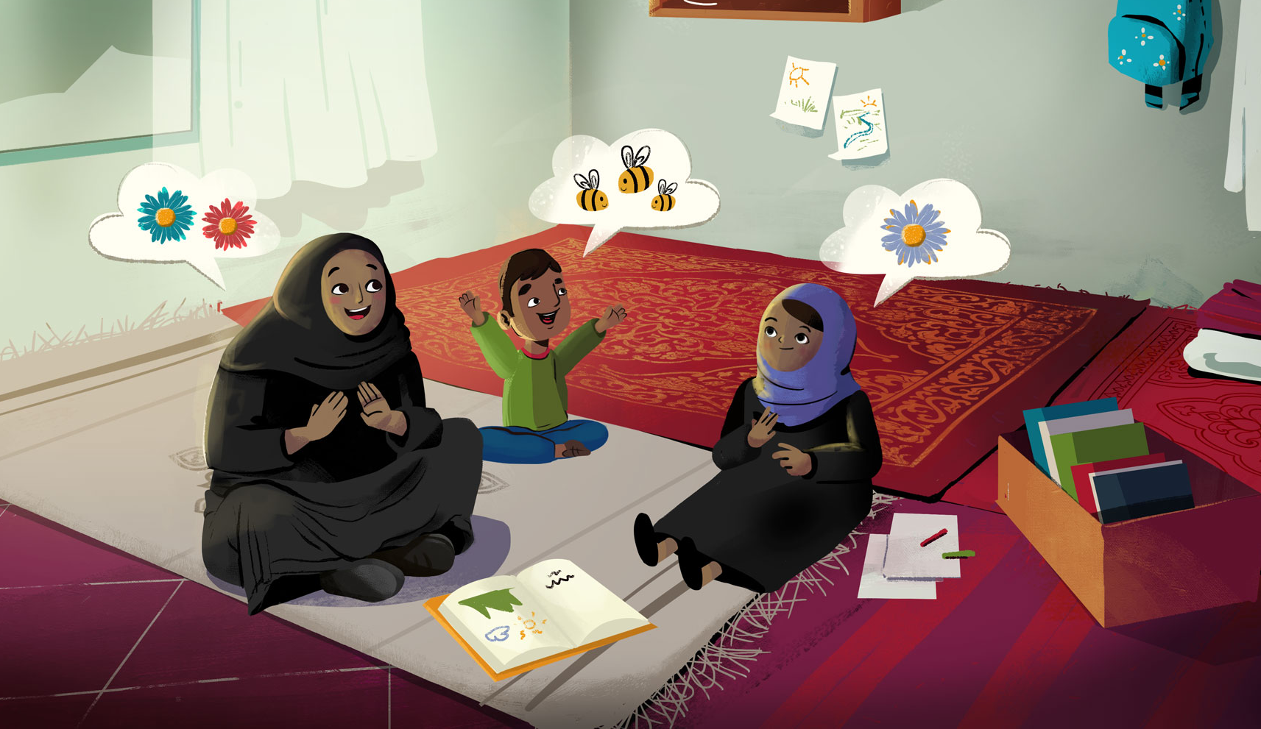
AFTER THE STORY
Ask your child to re-tell the story
Ask your child what they thought about the story
Write sentences or draw key events
Make up songs or act out key events

