Slide 1
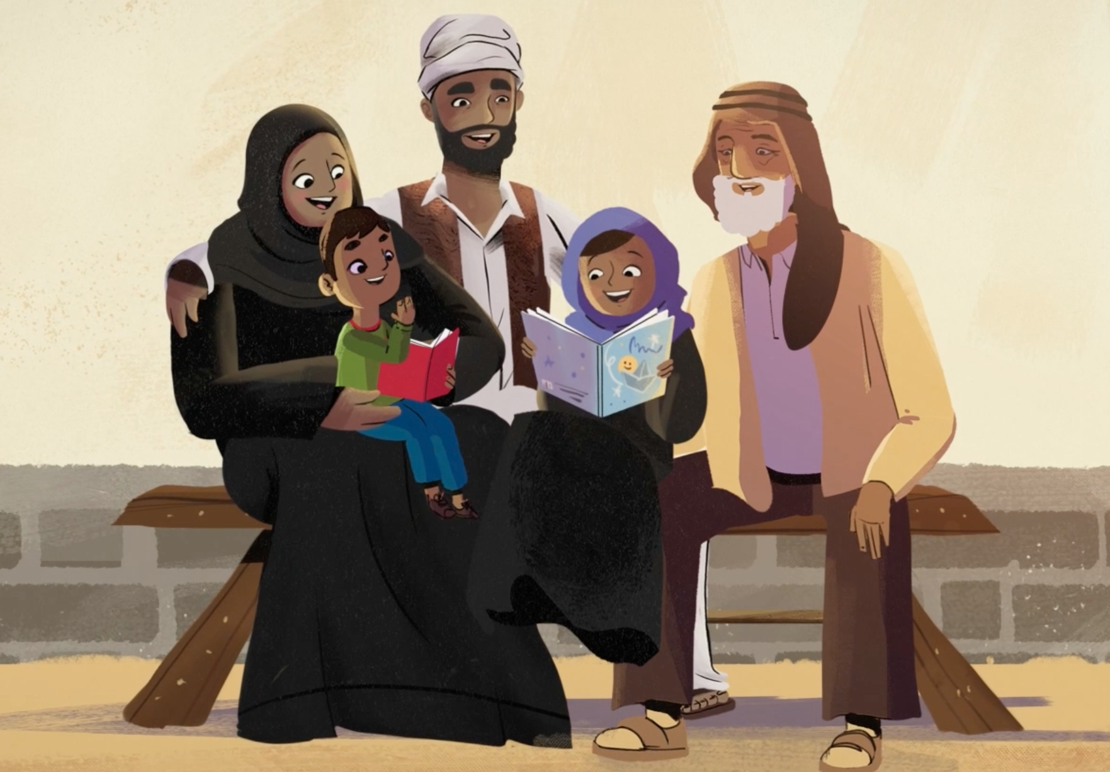
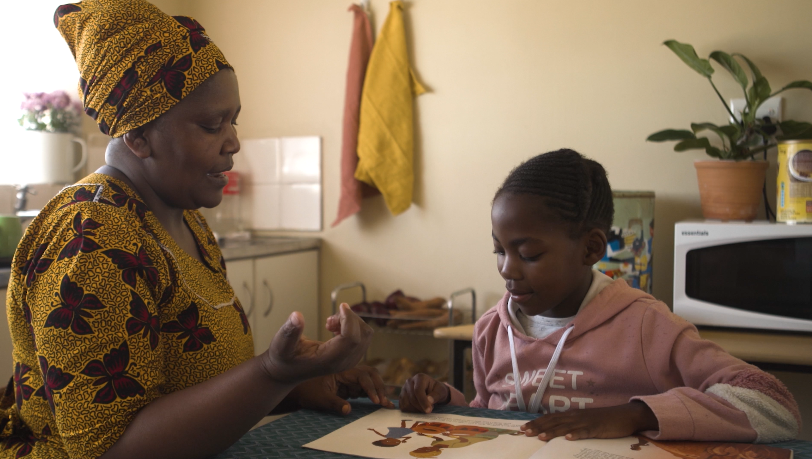
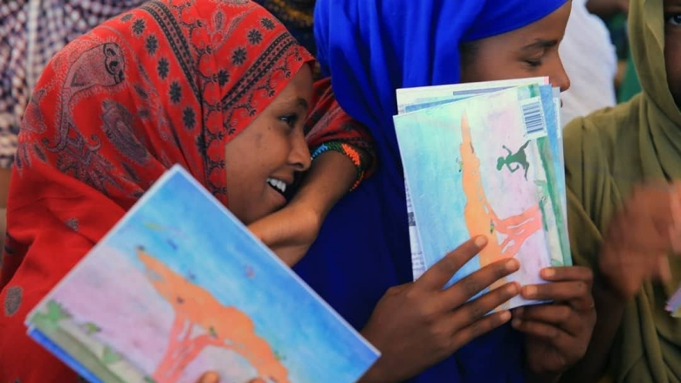
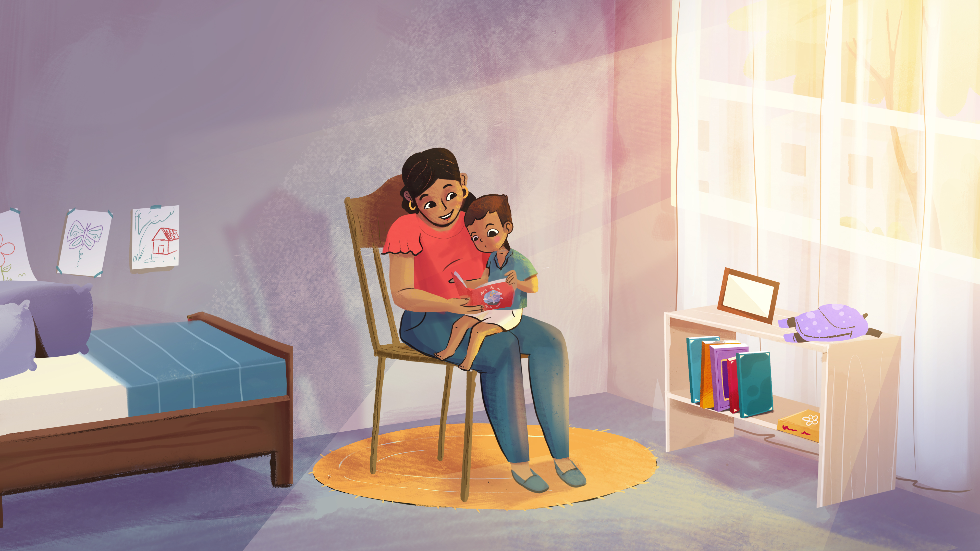
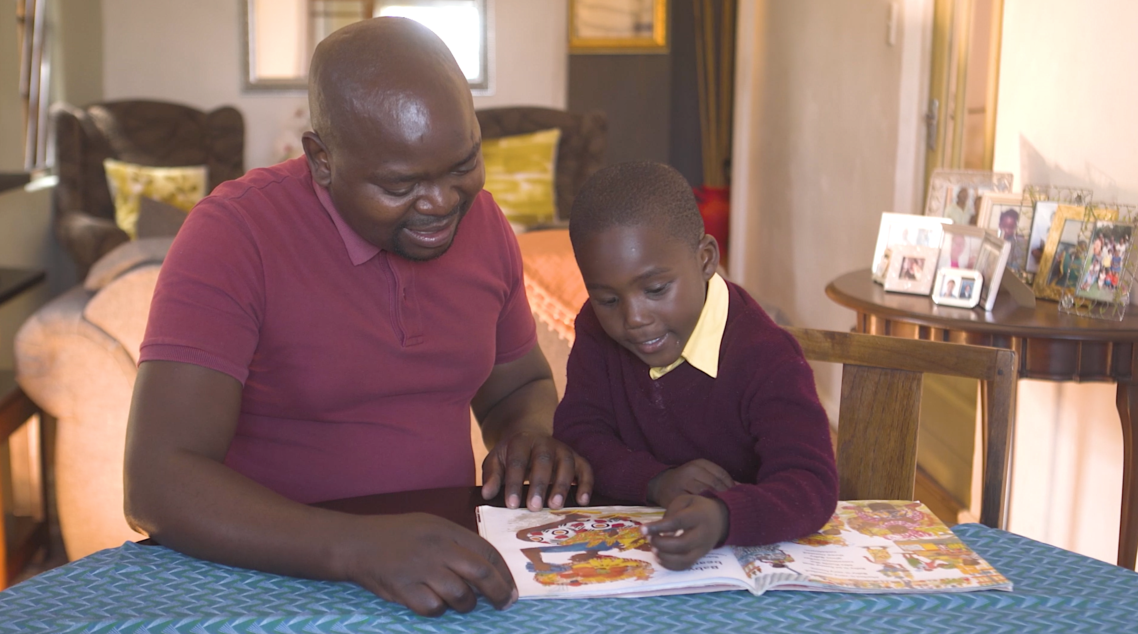
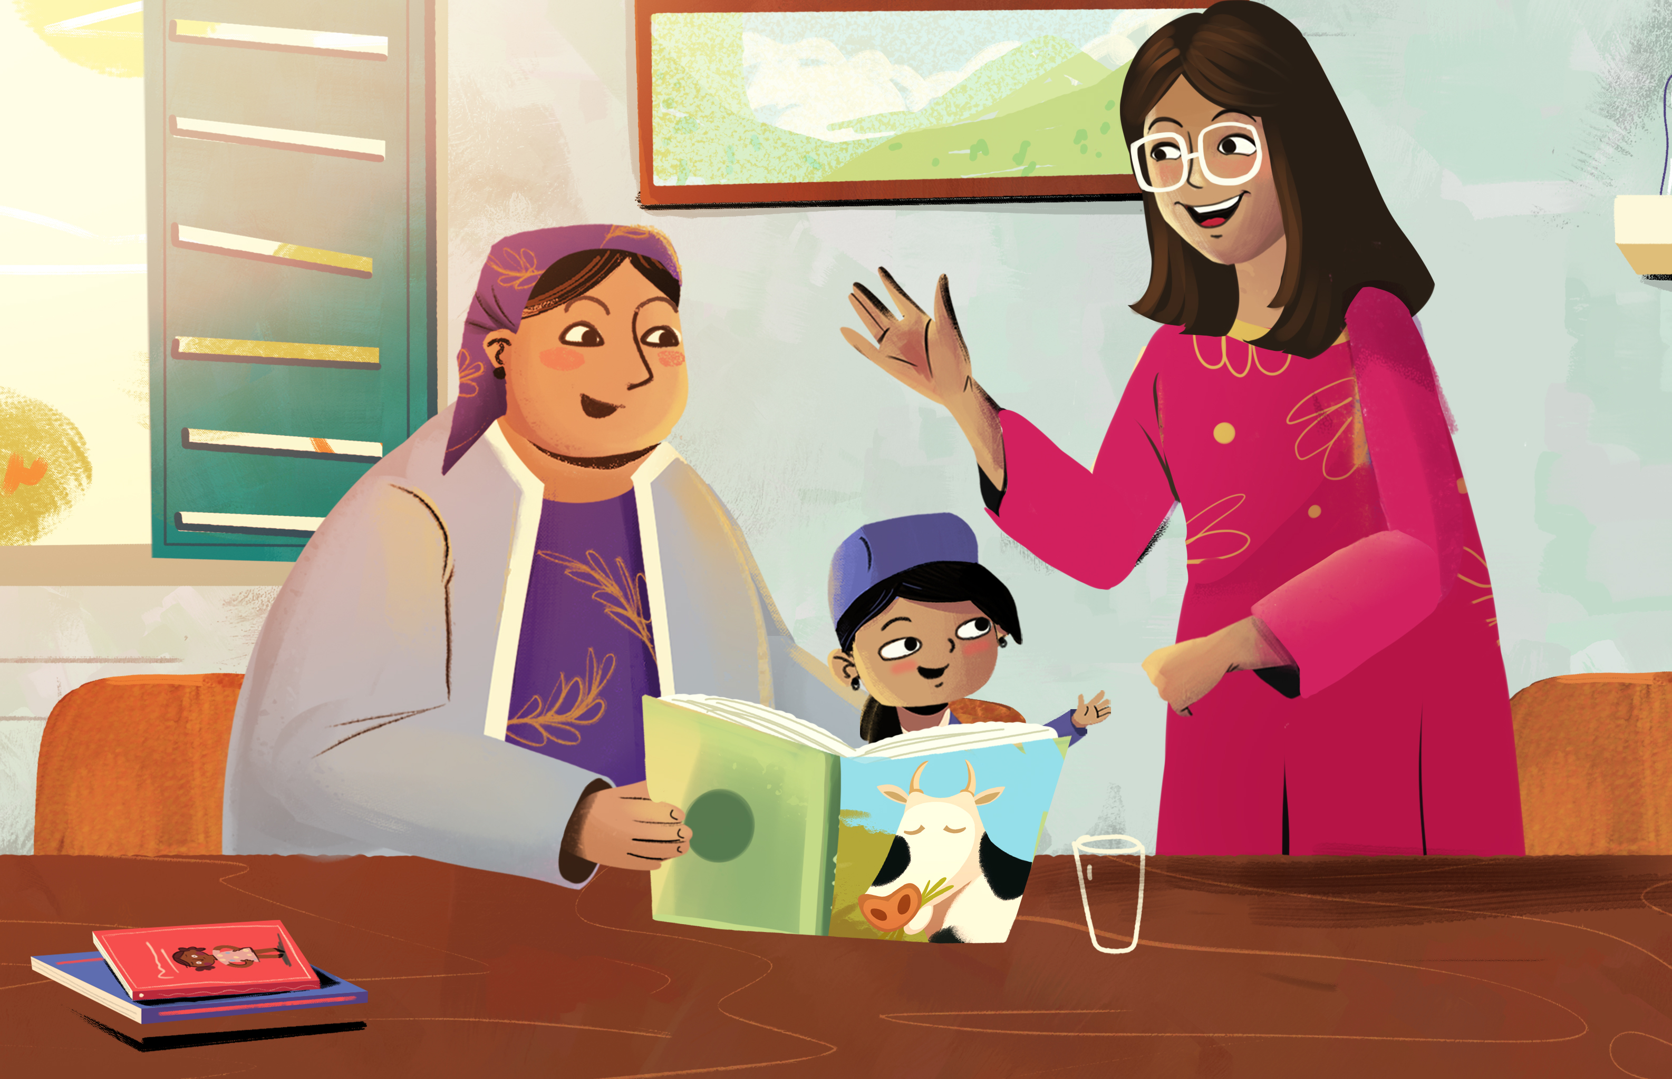

READ@HOME
Parental Engagement Materials
Orientation Booklet

Slide 2
CONTENTS
Introduction..................................................................................3
Read@Home content..................................................................4
Overview of available products.................................................5
Product requirements..................................................................6
Considerations for delivery.........................................................7
Adaptation guidelines.................................................................9
PRODUCTS:
Flip books.................................................................................10
Videos......................................................................................13
Handouts + discussion guides...............................................15
Posters......................................................................................16
Digital images and voice notes.............................................17
Materials for radio...................................................................18

Slide 3
INTRODUCTION
The Read@Home Initiative
The World Bank’s Read@Home initiative delivers reading and learning materials to hard-to-reach homes, as quickly and efficiently as possible, along with support for parents and other caregivers to engage with children’s learning.
Parental engagement materials
A comprehensive package of guidance materials have been developed to promote caregiver engagement in children’s reading activities at home. To effectively support all parents and caregivers to participate in Read@Home, these engagement strategies can be used by all parents and caregivers, regardless of their own literacy levels. The package of materials presents content through a variety of formats (e.g., pictures, video, audio, and discussions), to improve the accessibility of messages to caregivers who struggle to read or cannot read themselves.
Country teams can select, adapt, and combine different products to reach the maximum number of caregivers in the most compelling way, while leveraging available services and resources.
Purpose of the orientation booklet
This booklet provides an overview of the different materials in the package, intended as a first line of products that teams can adapt and improve upon to suit their context.
The booklet includes considerations and guidance for selecting, adapting, preparing, and delivering content to caregivers via different delivery formats.
Note: While delivering content using technology (e.g., sending content to caregiver’s phones or using social media platforms such as WhatsApp to engage with caregivers) may not currently be feasible in many contexts, the package includes materials for digital delivery, which can be considered as access to internet and feature phones change over time.
3

Slide 4
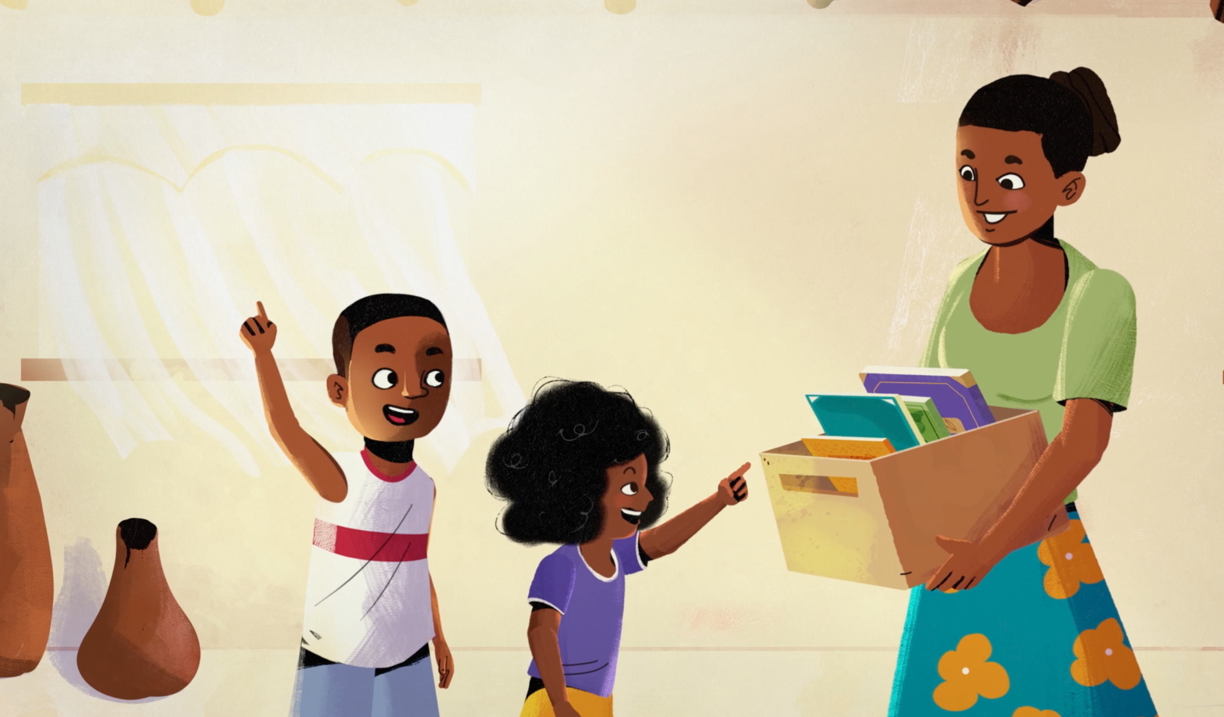
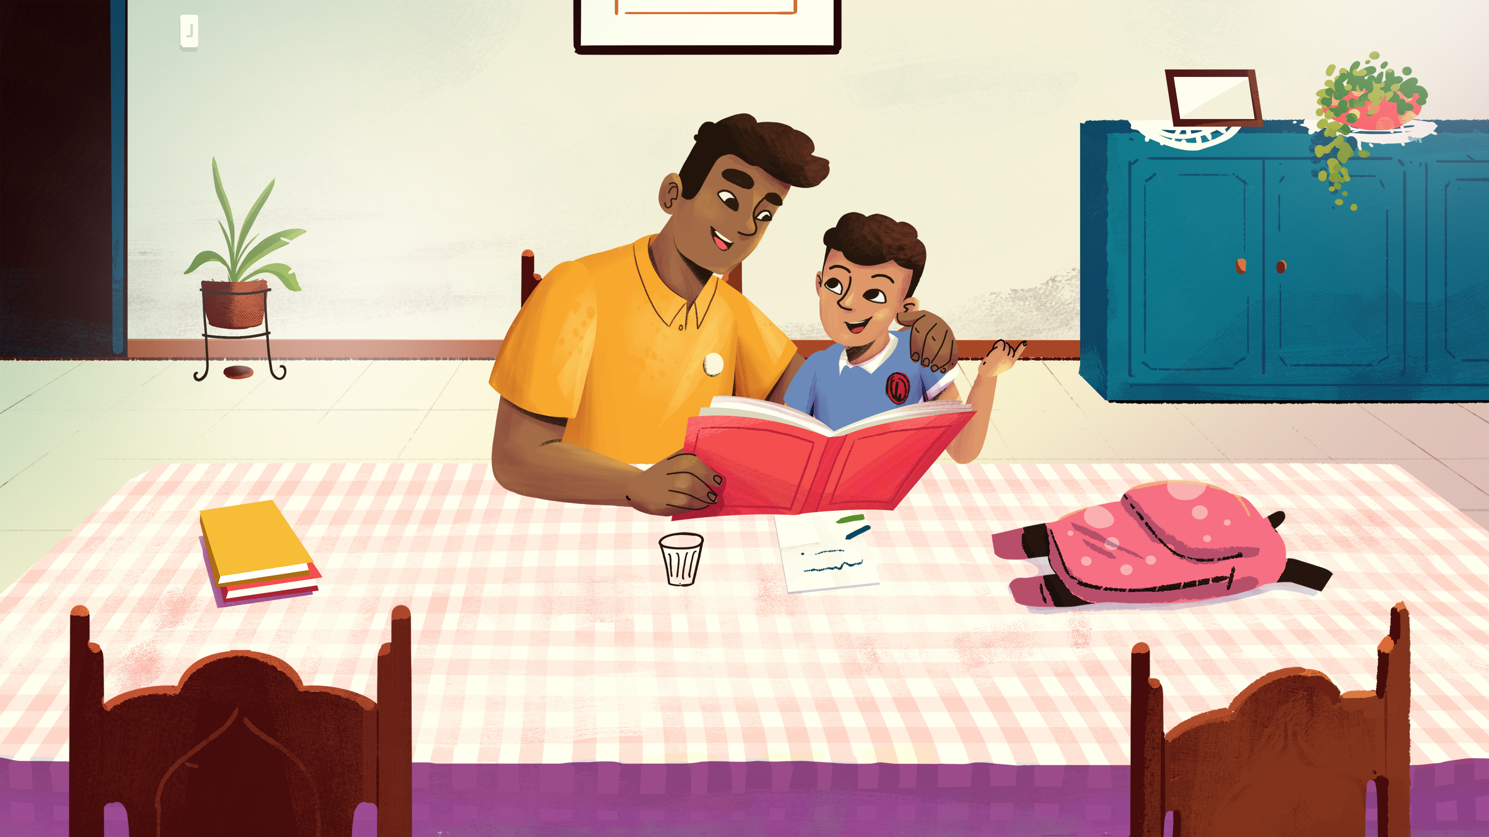
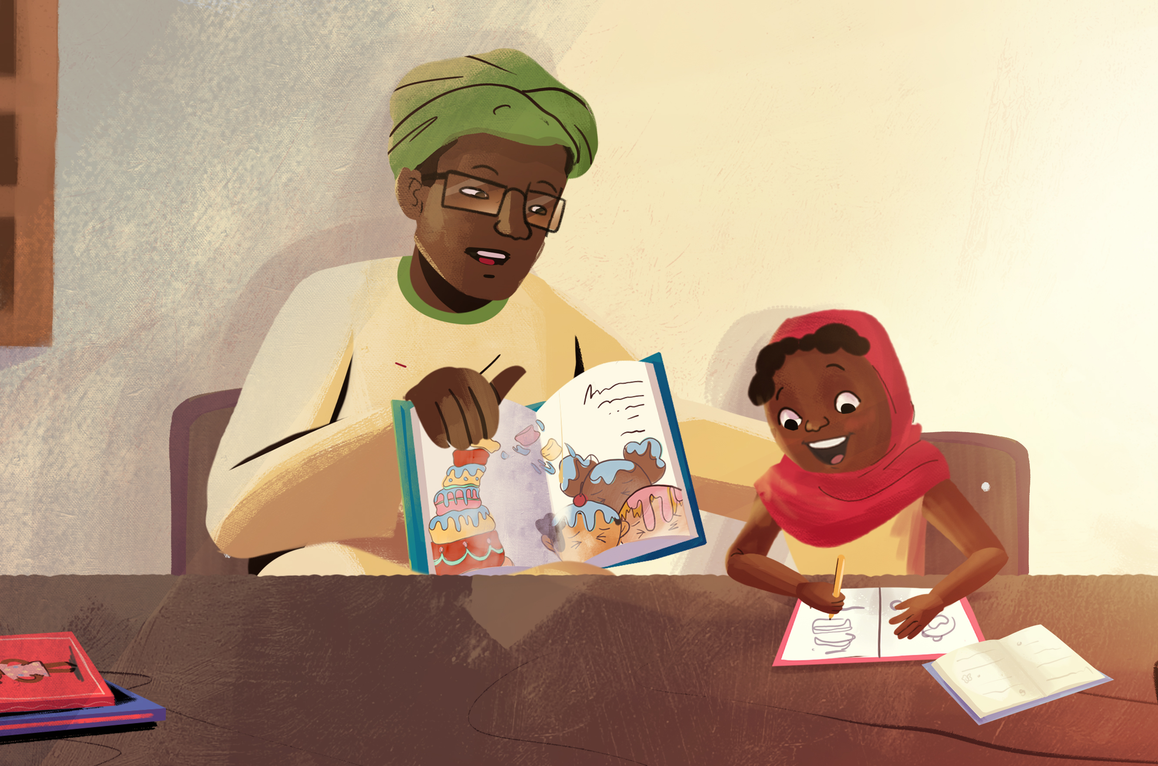
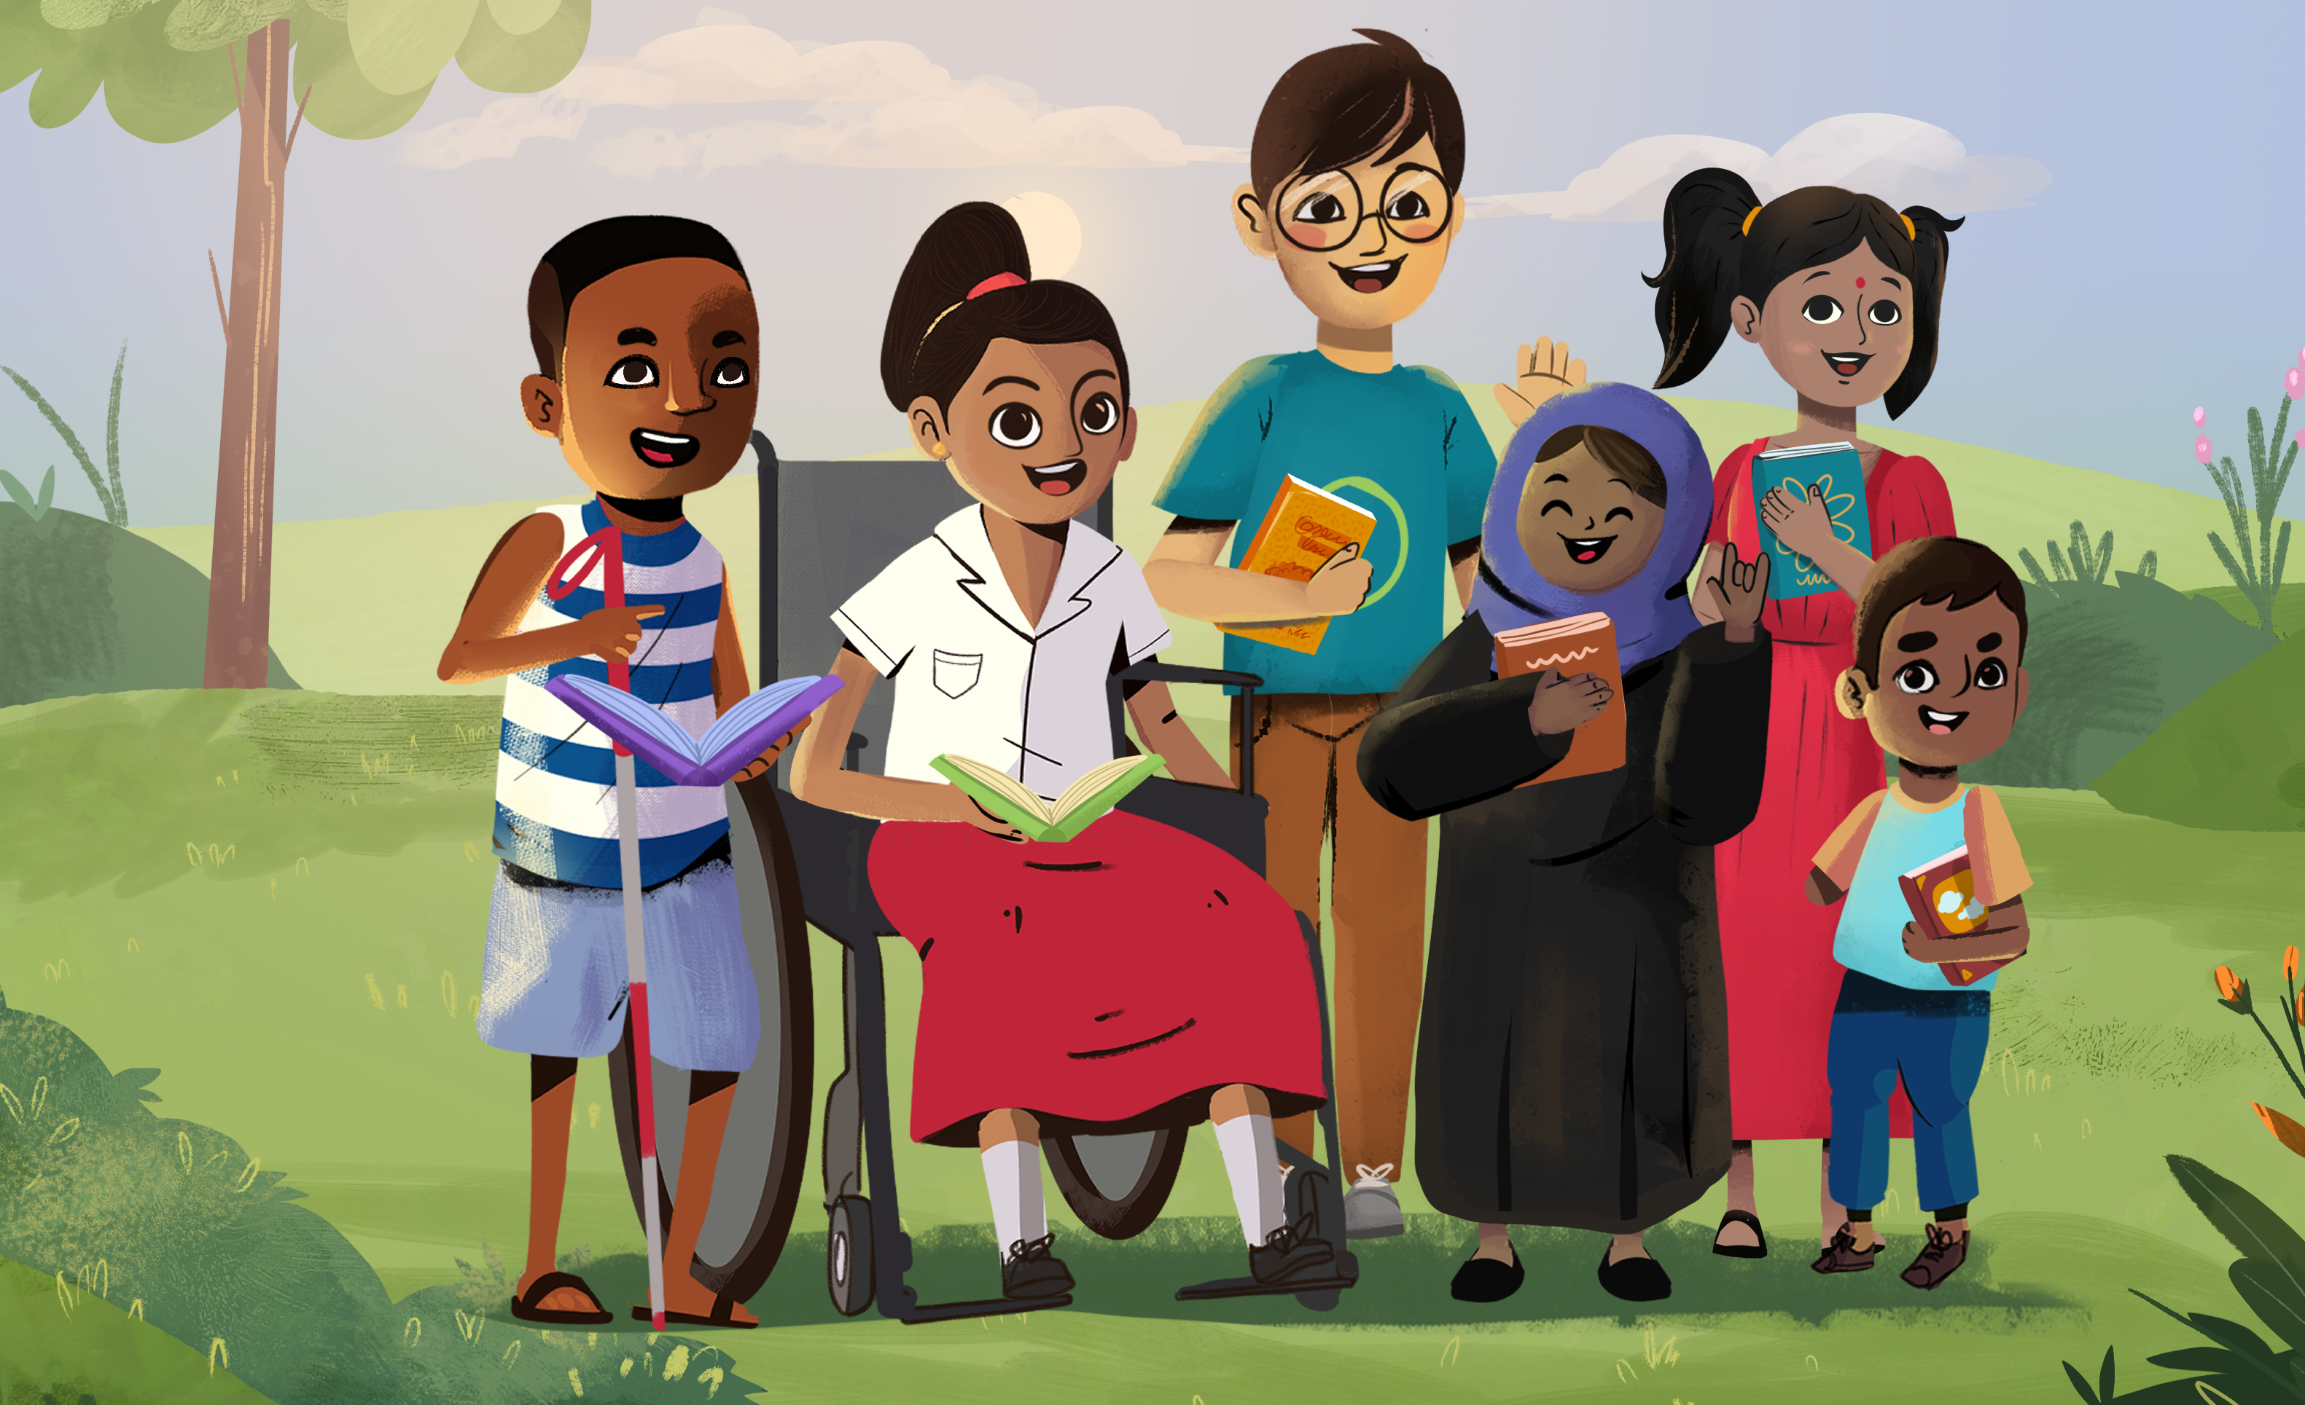
Read@Home parental engagement content:
Guidance for caregivers include content on the benefits of reading activities and caregiver involvement, along with practical examples of how caregivers can engage children before, during and after reading activities. These techniques do not rely on the book’s written text, so caregivers do not need to be able to read in order to use them.
An overview of the four main content sections is presented below:
INTRODUCTION FOR CAREGIVERS
Benefits of books and reading activities for children’s development and learning;
Importance of caregivers’ involvement, regardless of their own literacy levels.
BEFORE THE STORY
Guidance on how to set up a space for reading at home, how to make reading part of the daily routine, and how to introduce the activity to children.
DURING THE STORY
Examples of different engagement techniques (suitable for different child ages / reading levels) that caregivers can use as they go through the story with children.
AFTER THE STORY
Guidance and examples of what caregivers can do after the story to strengthen children’s learning from the book.
The Read@Home content also includes guidance for conducting reading activities with children with disabilities.
4

Slide 5
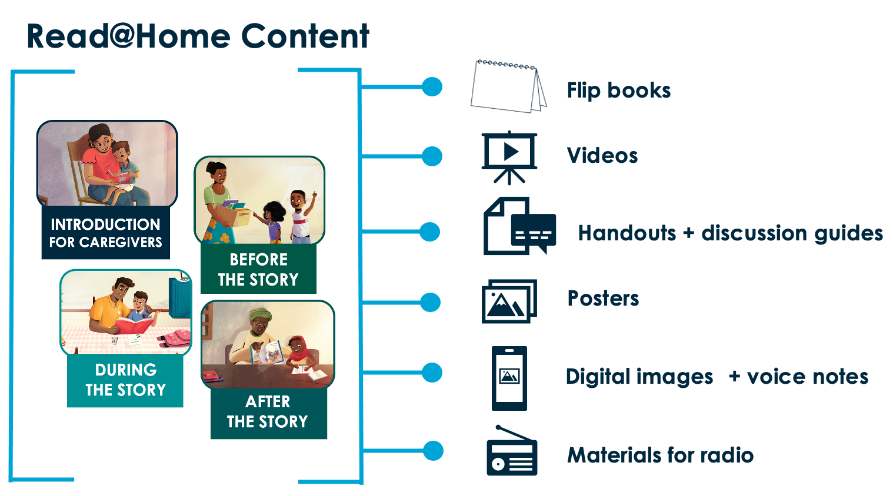







Overview of available products:
The content can be shared with caregivers via different products:
 | Flip books: Flip books contain visual materials to present to caregivers, with talking points for facilitators on the back. They can be used for in-person meetings with caregivers. Flip books vary in length to accompany different meeting frequencies (e.g., a six-session flip book or a three-session flip book).
 | Videos: Four animation videos and three “real-life” example videos demonstrate different caregiver engagement strategies. The full animation videos are also available as a series of shorter clips, which can be used as reminders of specific program messages. Video materials can be used for staff orientation and training or can be presented to caregivers during in-person meetings. They can also be sent to caregivers’ phones and shared on social media.
 | Handouts and discussion guides: Handouts (printed pictures with minimal text) can be distributed to families alongside books, which can be used to discuss key messages. Each handout is accompanied by a discussion guide, which can be used to discuss the content of the handouts with caregivers either in person, or over the phone.
 | Posters: Posters can be used to display key program messages or to advertise program activities and meeting details.
 | Digital images + voice notes: Digital images with minimal text can be sent to caregivers over platforms such as WhatsApp to illustrate key Read@Home activities. A voice note (short audio recording) can be sent alongside each image, to verbally explain the picture’s key message, and encourage practice.
 | Scripts for radio: Radio can be used to create awareness of the program and activities, to disseminate key messages, or to conduct a read-along or demonstration using local books.
To see the different language versions available, refer to Appendix A.
To access the online folders for the different products, refer to Appendix B.
5

Slide 6

Product requirements:
General requirements for producing and using different Read@Home products are provided in the table below:
PRODUCTS | REQUIREMENTS | REQUIREMENTS
 |  | Translation | Printing | Recording | Technology | Training
 | Flip book
 | Videos
 | Handouts
 | + discussion guides |  |  |  | (if using phone calls)
 | Posters
 | Digital images + voice notes
 | Radio messages
Additional requirements to consider:
EDITING: Where materials are translated or adapted, sufficient time and attention should be allocated to editing the different files, ensuring that the formatting, page numbers and file naming is correct.
FILE TYPE: When producing the final versions of products, make sure that the file types can be easily shared (e.g., compressed pdf files, png/jpeg image files, mp3 audio or mp4 video files) and that various file types opens successfully on different devices.
Teams should ensure that the image resolution is acceptable, for example, when printing handouts and large posters, or when reducing file size to share them over platforms such as WhatsApp). Data implications should also be considered when sending content to caregivers’ phones.
6

Slide 7
Considerations for delivery:
Teams need to consider which product (or combination of products) can feasibly be used in their context to effectively distribute Read@Home content to caregivers. Products may require translation and adaptation prior to use. The following key questions can inform product selection and the delivery approach:
How will content be delivered to caregivers: in-person, remotely, or a combination approach?
  In-person: Use the facilitator flip book (compliment with videos, picture handouts)
  Remotely: Use picture handouts and phone calls, digital images + voice notes, video and/or radio.
Can technology be used to deliver content to caregivers? What types of technology are available (e.g., radio, mobile phones, basic feature phones / smart phones)? How will data cost implications be considered?
Will meetings with caregivers take place in a one-on-one or group setting? How many caregivers will participate?
How many meetings will there be? How frequently will the meetings take place? How long will the meetings typically last?
Is there scope for follow-up or check-in contact with caregivers in between meetings?
Who will deliver the content to caregivers? How will they be trained? How will they be supervised?
Ideas for combining products based on the resources available are provided below:
No technology: | conduct face-to-face sessions, using flip book + distribute picture handouts and discuss the handouts with caregivers in person
Facilitator has phone / laptop / projector: | + show videos (animations and demonstration videos) to caregivers during sessions
Caregivers have basic mobile phones: | + discuss the handouts and activities with caregivers over the phone
Caregivers have feature phones: | + send digital images and voice notes + send animation clips
Caregivers have radios: | + disseminate messages on radio
7

Slide 8
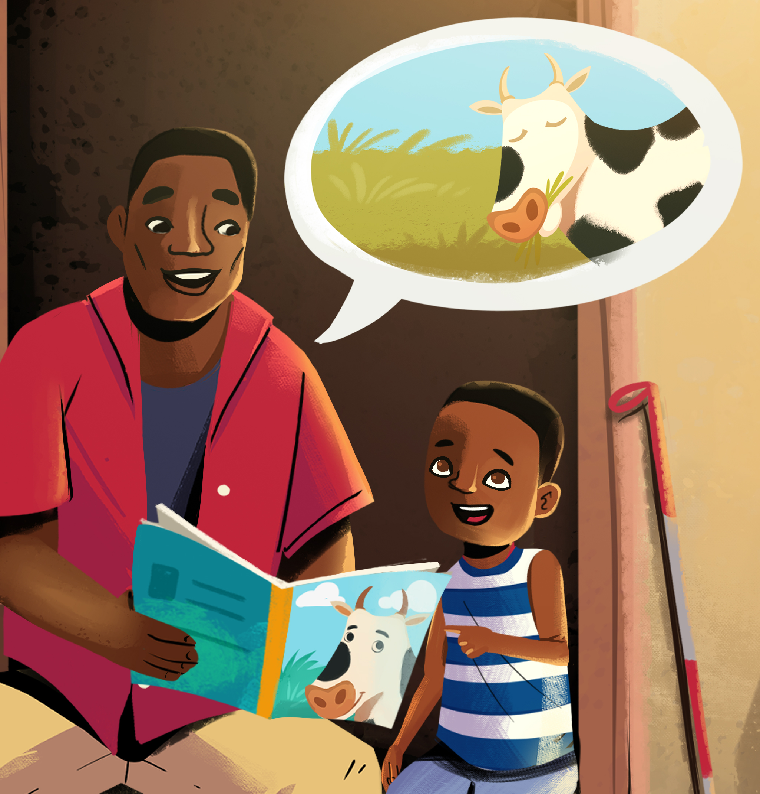
Considerations for delivery:
Best-practice guidelines for delivering Read@Home content
While the following approach will not be feasible in all settings, teams are encouraged to select an approach that aligns as closely as possible with best-practice recommendations, but that suits their context, resource availability and implementation capacity.
The ideal method of delivering the Read@Home content to caregivers is through:
In-person meetings, either with caregivers at their homes or during small group meetings (groups of 10-15 caregivers or less).
A series of meetings (ideally 6 or more sessions, using the facilitator flip book) to provide sufficient opportunity to orient caregivers to Read@Home, introduce different techniques gradually, and provide opportunities to practice and assimilate key skills.
Meetings hosted by a trained facilitator from the community (e.g., a teacher or community worker) with experience working with parents and caregivers, who speaks the language of the community.
Training for facilitators that takes place over a minimum of 3 days and includes a close review of all content, with opportunities for facilitators to practice presenting the content and conducting demonstrations using books. Training materials (proposed agenda, presentation materials, and training activities) are provided alongside this package.
Facilitators should receive regular supervision and support as they implement the program.
Meetings should provide enough time to cover the session activities at an acceptable pace. One-on-one visits should last no more than 60 minutes. Group sessions should last between 45-90 minutes, depending on the size of the group.
In-person meetings should be complimented with other contact points to strengthen message delivery. In between meetings, caregivers should ideally receive reminder messages or brief check-ins to discuss their progress or challenges. Disseminating messages at a wider community level (e.g., using posters, television or radio) is beneficial to encourage and support behavior change.
We recommend that guidance provided to support children with disabilities should not be omitted from the program and should be presented to all caregivers. This is because techniques that are useful for children with disabilities are useful for all children. Where facilitators work directly with a family with a child with a disability, they should pay additional attention to messages that are relevant to the child and their abilities. The training materials and facilitator flip books contain guidance for facilitators to support caregivers of children with disabilities.
8

Slide 9
Adaptation guidelines:
Products may need to be adapted prior to delivery. The following questions can guide the adaptation process:
Dimension: | Questions:
Language | What language or languages will be used? (select the language / languages that the target group will understand best, e.g., a local language above the language of instruction). Who will translate the content and and ensure that translations are appropriate for the target group (e.g., translations should be clear and simple and avoid overly formal language) Do messages need to be simplified further to improve understanding?
Persons | Are target caregivers and families represented in the materials? Are any visuals inappropriate for or irrelevant to the context? Do they need to be replaced? How will they be replaced? Are examples and practices relevant to caregivers or do they need to be adapted? Are suggested contact points and interactions between facilitators and caregivers appropriate? (e.g., who is targeted, when and where contact is made, and how facilitators engage with parents) What needs to be added to the facilitator training to ensure that interactions are appropriate and supportive?
Content (and metaphors) | Is the content and activities acceptable and appropriate for this context? Is there any of the content or activities that need to be adapted so that it is better understood in the context? Does any of the content need to be removed or changed? (e.g., messages about making eye contact during reading; imagery such as rainbows; content about reading spaces, reading times, or who is involved in children’s reading activities?)
Methods | What delivery format is acceptable to the target population (e.g., including partners or other family members, appropriate meeting locations; meeting times; meeting protocols)
Context | What adaptations are required to: Address barriers to participation (e.g., child care needs, financial barriers, caregivers with disabilities) Address barriers for facilitators (e.g., time and place of sessions, transport and logistics, equipment, training, support) Effectively consider issues unique to the context (e.g., family composition, humanitarian crises or conflict; environmental and geographical challenges)
Adapted from the Ecological Validity Model, a framework to guide culturally sensitive adaptations of interventions.
9

Slide 10


Flip books:
Flip books contain visual materials to present to caregivers, with talking points for facilitators on the back. This is the main product in the package as it contains all the information facilitators need to orientate caregivers to the program, present different skills and support caregivers to practice the skills.
Two versions of each flip book are available: in each version the content is the same, but the images include families of different ethnic backgrounds. Teams should select the version with images that best suits their context.
Version 1:
Version 2:
Flip books vary in length to accompany different meeting frequencies. Teams can select a flip book (options listed below) to correspond with the number of meetings they are able to have with caregivers:
  6-session flip book (content delivered over 6 meetings)
  5-session flip book (content delivered over 5 meetings)
  4-session flip book (content delivered over 4 meetings)
  3-session flip book (content delivered over 3 meetings)
  2-session flip book (content delivered over 2 meetings)
The flip books prompt facilitators to present each session using the following format:
  Welcome / greeting
  Check-in (how things have gone since they last met)
  Recap of the previous session’s content
  Introduction of new content (includes demonstrations and practice opportunity)
  Summary of key messages
  Reflections and commitments
The flip books can be used with caregivers in one-on-one consultations or small group meetings. One-on-one visits should last no more than 60 minutes. Group sessions should last between 45-90 minutes, depending on the size of the group.
It is strongly recommended that, where possible, the 6-session flip book or 5-session flip book is used, as this will provide caregivers with the most in-depth knowledge of read-at-home activities, and sufficient opportunity to practice and assimilate the skills.
10

Slide 11
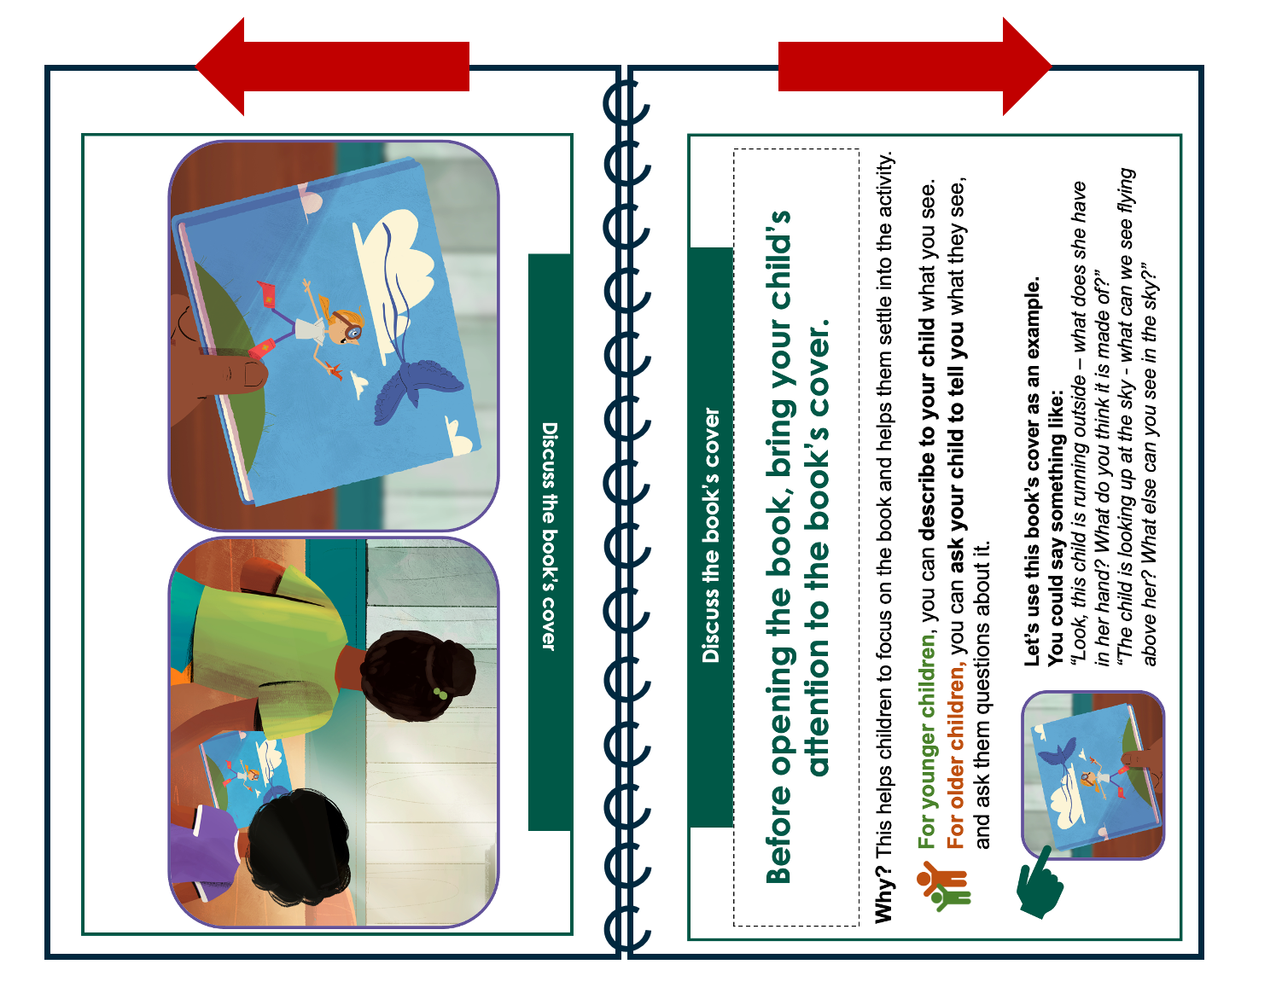
Flip books:
The table below outlines important considerations for teams planning to use the flip books.
ADAPTATION | Conduct a careful review of the flip book content, to identify if any messages or imagery requires adaptation. For example, messages about making eye contact during reading activities might not be culturally appropriate in all settings, in which case this message can be omitted. If any content is added or removed, take care to update the page numbers accordingly.
TRANSLATION | All flip book content should be translated so that it can be presented to caregivers in a language that they understand. Having translated flip books (as opposed to facilitators translating as they conduct sessions) helps to standardize the delivery of program messages. Sufficient time should be allocated to translation, with opportunity to review the accuracy of translations before printing the final versions. Where possible, involve facilitators in the review process, as this will help them to become familiar with the content. Once translations have been completed, make sure that the formatting of each page matches the English template as closely as possible.
PRINTING INSTRUCTIONS | PAPER: Paper size: A4 or A3. An A4 size flip book is suitable for one-on-one sessions, whereas larger flip books (A3 size) improves visibility for caregivers during group meetings. Paper type: Use a thicker type of paper (170 gsm or more) and laminate the front and back pages for durability. Make sure that the thickness of the paper is suitable for double-sided printing. PRINTING REQUIREMENTS: Flip books should be printed in colour, double-sided (flip on long edge). NB: Print in landscape with pages facing in opposite directions: BINDING: Flip books should be bound in landscape on the top (long edge) of the page, using a durable spiral binding:
11

Slide 12
Flip books:
TRAINING | Prior to implementation, facilitators should receive training in how to use the flip books and conduct sessions with caregivers. For the training, trainers can use the 6-session version of the flipbook as this covers all program content in detail. Training for facilitators should: Provide an overview of the project, materials and activities. Include a close review of all content areas: Introduction for caregivers Before the Story techniques During the Story techniques After the Story techniques The four animation videos and 3 demonstration videos are useful training materials. Present these to the group and allow opportunity for questions and discussion. These videos are included in the training presentation template. Include a clear breakdown of the structure of each session and key facilitation skills. Provide opportunities for facilitators to role-play presenting the content, with trainers providing feedback. Allow facilitators to review the books that will be distributed to families, and brainstorm how they could use the books to demonstrate different skills.
COMBINING FLIP BOOKS WITH OTHER PRODUCTS | Below are some ideas for combining flip books with other products: VIDEOS: Where facilitators have access to equipment (e.g., a tablet device, laptop or projector), the animation and demonstration videos can be presented as part of group sessions or home visits. Alternatively, the shorter animation clips can be sent to caregivers with smart phones, as reminders of key messages in between sessions. Phone access, connectivity and data will need to be considered. DIGITAL IMAGES + VOICE NOTES: Where caregivers have access to phones or messaging platforms such as WhatsApp, facilitators can send digital images and voice notes to caregivers in between sessions as reminders of key messages. Phone access, connectivity and data will need to be considered. PHONE CALLS: Phone calls to caregivers can be used to: discuss the picture handouts with caregivers provide reminders of key messages conduct brief check-ins and determine if caregivers face challenges, have questions or require additional support.
12

Slide 13
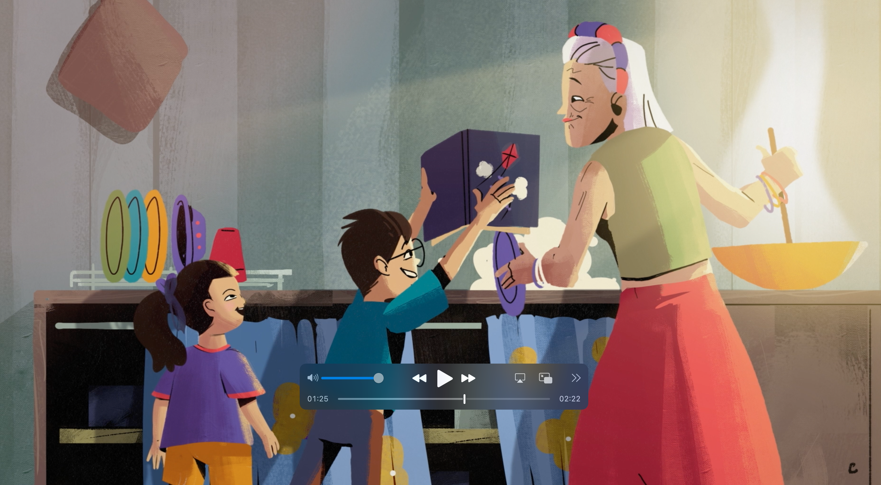
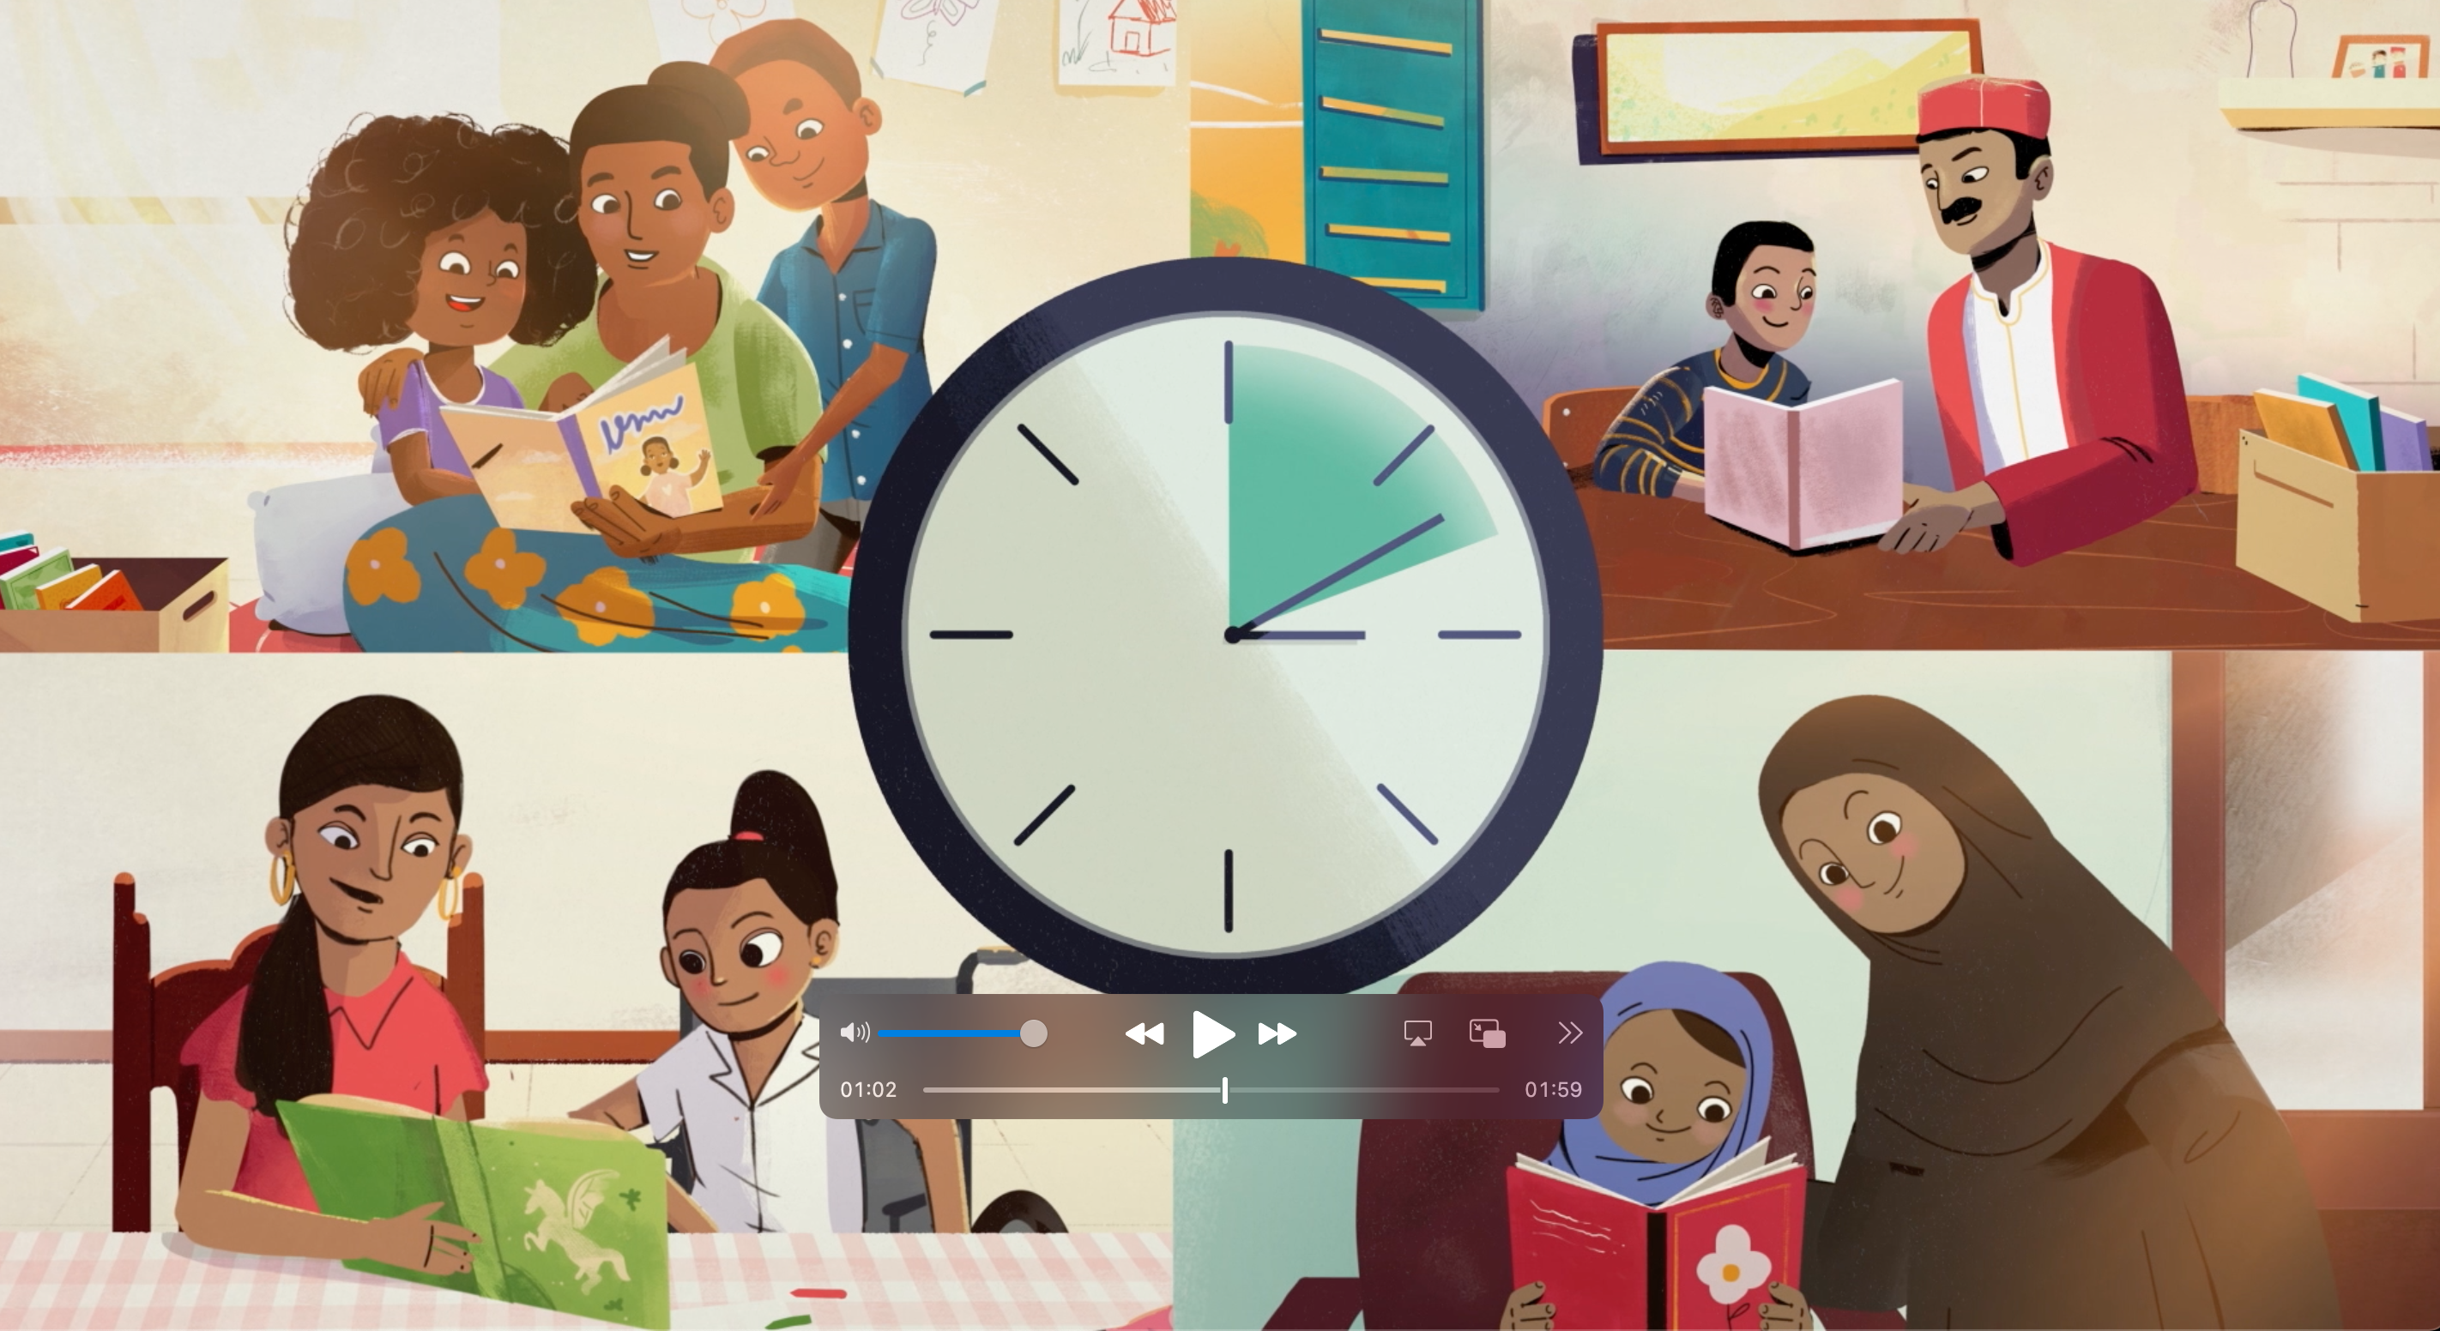
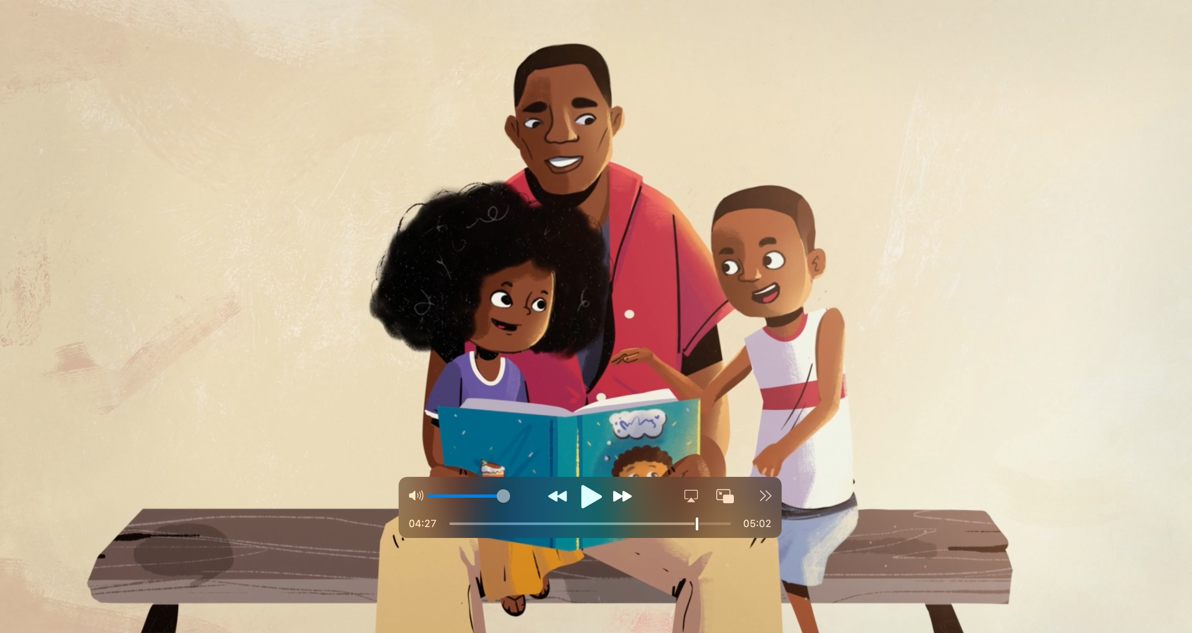
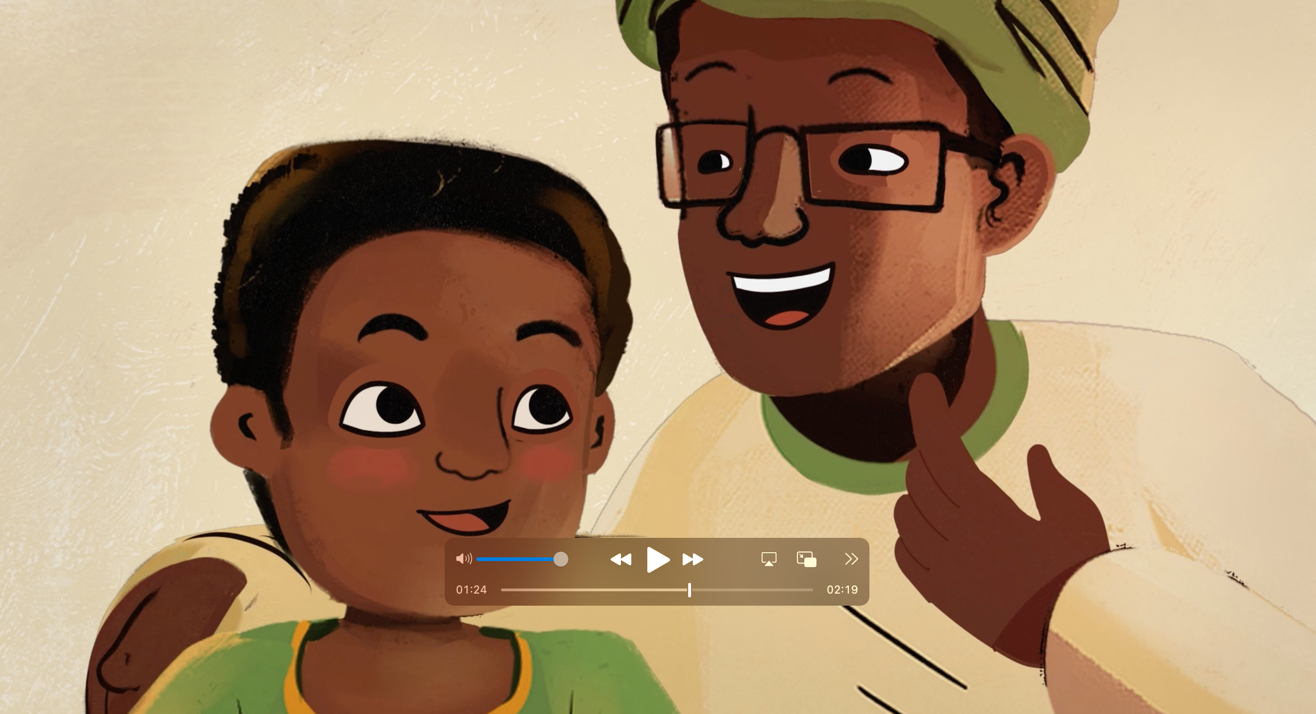
Videos:
A series of video products are available to:
support the orientation and training of staff;
provide caregivers with practical examples and demonstrations of different read-at-home activities.
1) ANIMATIONS
Four animation videos (2-5 minutes each) are available to introduce the importance of caregiver involvement in reading activities, and to demonstrate different activities that caregivers can do at home to support their children’s learning (before, during and after the story).
The videos showcase a variety of family compositions, cultures and home environments.
Each video has a voice-over, which can be translated into local languages.
1. Introduction (02:22)
2. Before the Story (01:59)
3. During the Story (05:02)
4. After the Story (02:19)
Animation clips:
The full animations have also been edited into shorter clips, which link directly to specific program messages (e.g., setting up a reading space at home or connecting events in the book with children’s own experiences).
How to use the videos: Using a phone, computer or projector, animations can be presented as part of staff orientation and training, or in-person meetings with caregivers.
Alternatively, they can be sent to caregivers with phones (e.g., over WhatsApp or other social media platforms) as reminders of the messages that were covered during the session. Where clips are sent to caregiver’s phones, teams will need to consider costs associated with data – both for facilitators and caregivers.
13

Slide 14
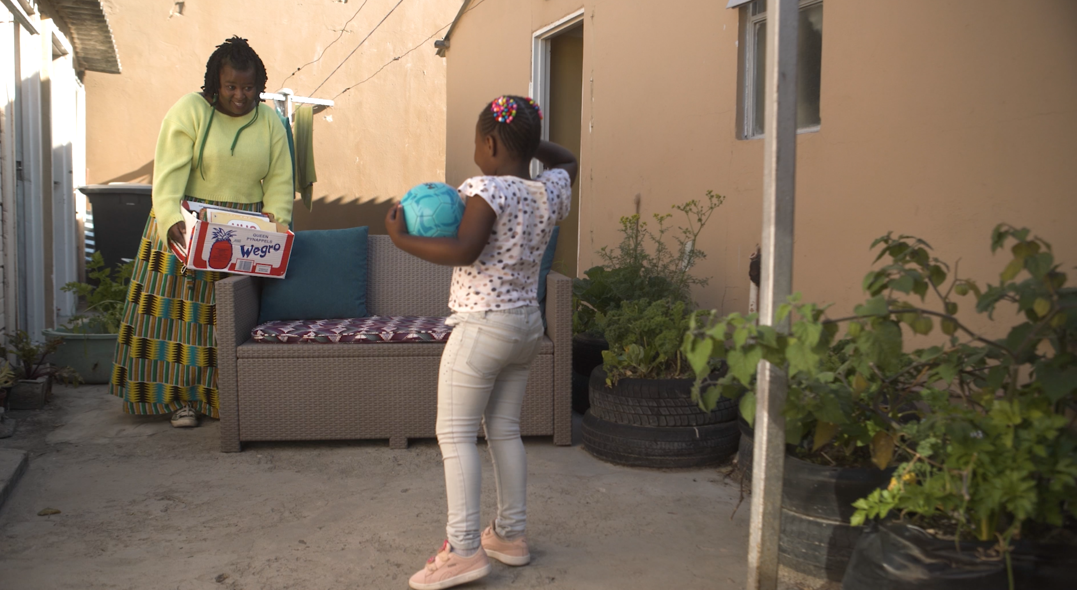
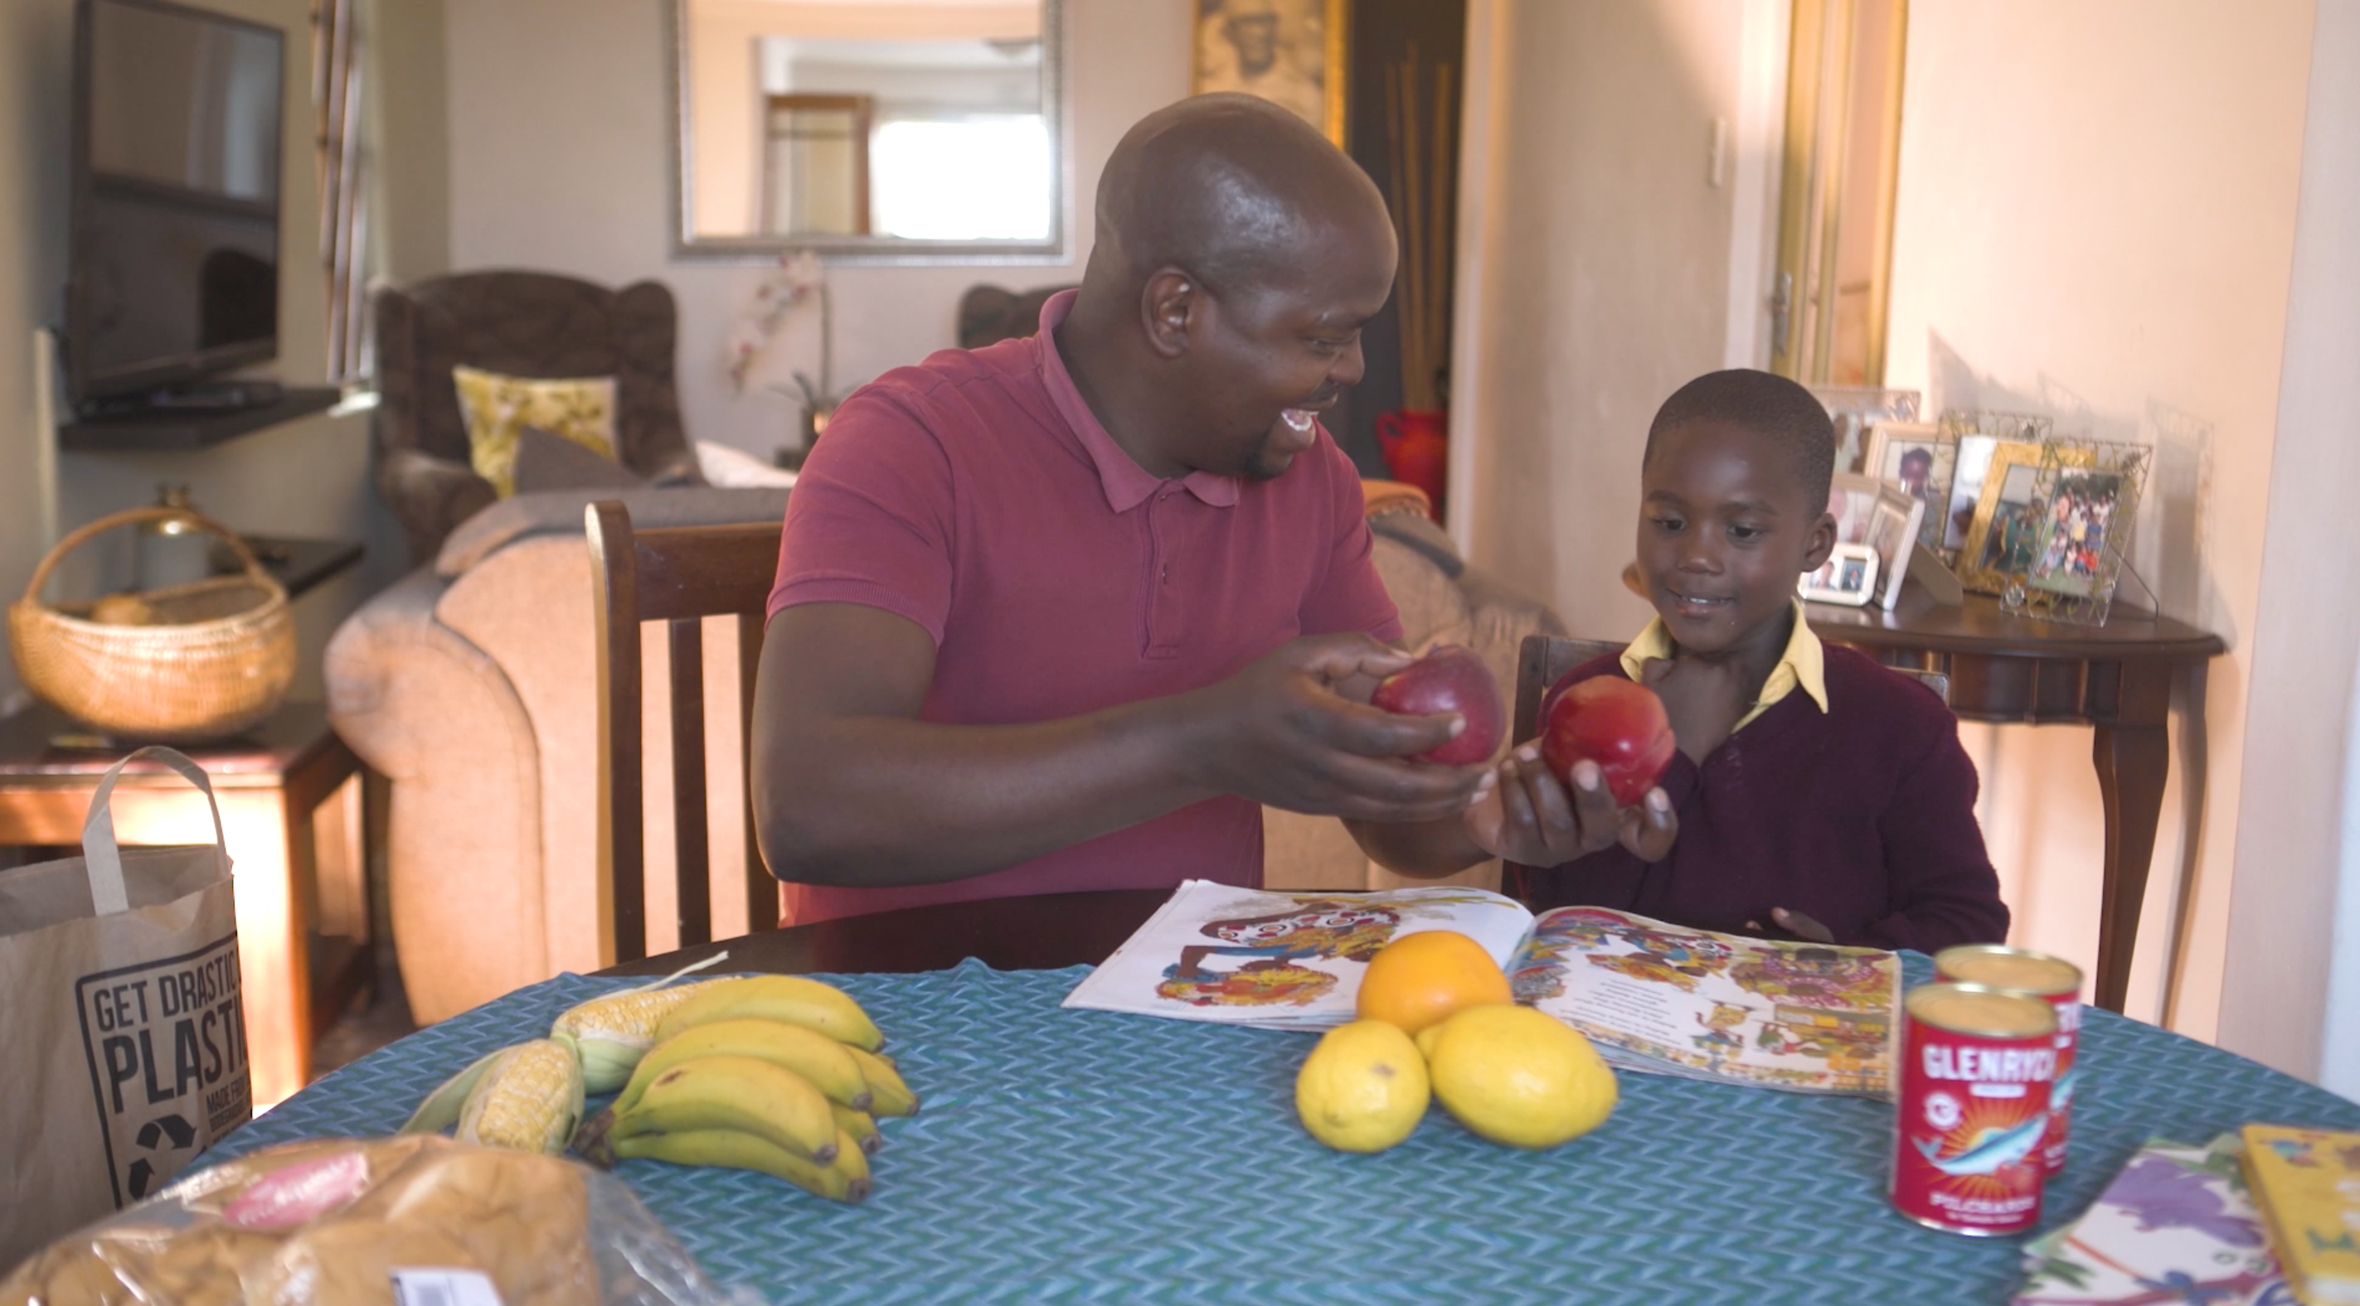
Videos:
2) “REAL-LIFE” DEMONSTRATION VIDEOS
Three demonstration videos were developed to provide real-world examples of caregivers conducting reading activities with children, showcasing a variety of techniques. Each video has a voice-over that provides an explanation of the techniques demonstrated in the video. The voice-over can be translated into the local language and recorded to replace the English voice-over. Alternatively, teams can use these demonstration videos as example references to record their own videos with local caregivers and children. Facilitators who have been trained in the program can act as the caregivers in the videos.
DEMO 1
Setting up a reading activity
Demonstrating emotions
Asking questions about the characters and events
Discussing and explain emotions
Mimicking actions from the story
Making connections between the book and the child’s world
DEMO 2
Making connections between the book and the child’s world
Using the pictures and other household objects to help children understand different categories (e.g., shapes and colors)
The importance of praise
DEMO 3
Listening to child read aloud and asking them questions about what they are reading
Discussing new words or concepts
Describing the pictures
Drawing pictures and writing sentences to reinforce learning
Involving other family members
Considerations for using video materials:
Equipment to view videos (phones, tablets, computers or projectors)
Electricity and data requirements
Translation of voice-overs into the local language
Recording of translated voice-overs. Make sure that the person conducting the recording uses an engaging voice, speaks clearly and not too quickly, and that there is limited background noise.
Adding the translated audio to the video (requires some video editing skills)
Note: If teams are unable to record a new voice-over, the video can be shown without sound, while the presenter speaks to what is happening in the video. The voice-over script can be printed out and used to guide their discussion of the video content.
14

Slide 15
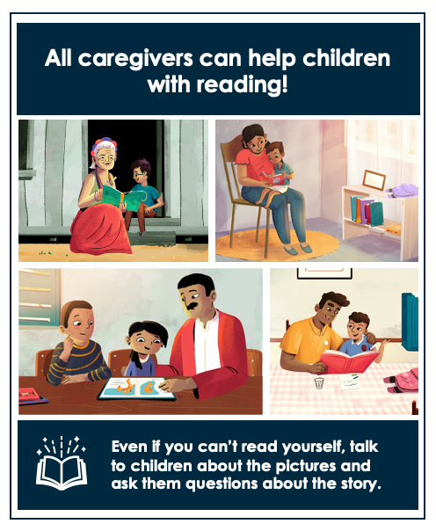
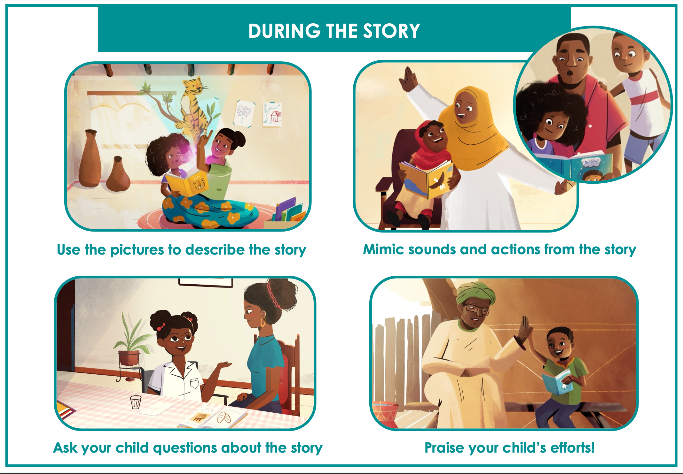
Handouts + discussion guides:
Handouts are printed pictures with minimal text that demonstrate key program messages and activities. They can be distributed to families alongside books or discussed during brief meetings (in-person or over the phone). Each handout is accompanied by a discussion guide, which can be used to discuss the content of the handouts with caregivers either in person, or over the phone.
Two versions of each handout is available, showcasing families of different ethnic backgrounds. Teams should select the version with images that best suits their context.
The following sample handouts are available:
Introduction
Benefits of Reading Activities
What to do Before, During and After the Story
Supporting Children with Disabilities
Handouts can be printed and distributed individually, or all in one pack.
Handout examples:
Considerations for using picture handouts:
Text needs to be translated.
Printing: handouts should be printed on A4 paper, in color.
Discussion guides need to be translated.
Facilitators should be trained on using the discussion guides.
Where handouts are discussed telephonically, facilitators will require airtime and caregiver contact details to conduct phone calls.
Where handouts are discussed telephonically, facilitators should make sure that caregivers have the correct handout in front of them.
15

Slide 16
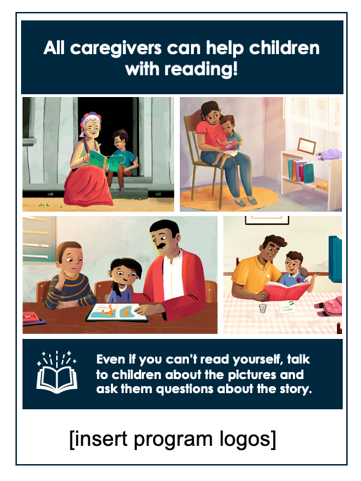

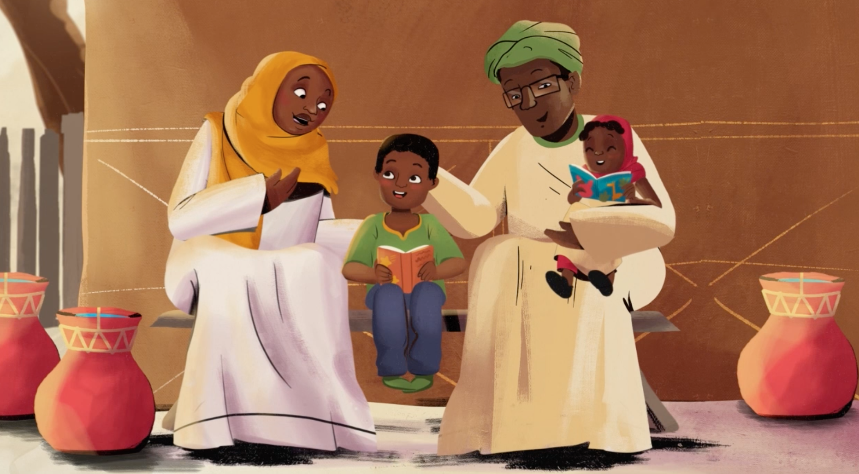
Posters:
Posters can be used to display key program messages or to advertise program activities and meeting details in the community.
Two versions of each poster template is available, showcasing families of different ethnic backgrounds. Teams should select the version with images that best suits their context.
Poster template examples:
Want to help your child do better at school?
Join the READ@HOME program!
[add details]
[add details]
Considerations for using posters:
Poster text needs to be translated
Posters should be printed in color
Size can vary, depending on where it is used
Teams can also use photos of local families on the posters
[insert logos]
16

Slide 17



Digital images + voice notes:
Digital images can be sent to caregivers' phones as a reminder of key program messages. Each image is accompanied by a voice note (a short audio recording) that explains the key message in the picture and encourages caregivers to try the activity at home.
Facilitators can send the image and voice note to individual caregivers, or use group messaging (e.g., via WhatsApp groups). WhatsApp groups (consisting of 20-30 caregivers) can be an easy and effective way to send content to multiple caregivers. The groups can also serve as a source of peer support, where challenges can be troubleshooted and successes can be shared. Caregivers with phones can also be encouraged to meet with other caregivers in their community (especially other caregivers who do not have access to phones) and share content with them.
An example digital image and accompanying voice note is shown below:
“No matter your child’s age, make sure you give them lots of praise! It might sound strange, but you don’t have to tell your child they are wrong or that they are making a mistake to help them learn. Rather, respond by offering them the correct word or answer. By correcting them in a positive way, you encourage them to keep talking and learning. We hope you find moments to praise your child during your next reading activity!”
Considerations for using digital images and voice notes:
Voice notes need to be translated.
Voice notes need to be recorded. Make sure that the person conducting the recording uses an engaging voice, speaks clearly and not too quickly, and that there is limited background noise.
Data and caregiver contact information will be required to send the content to caregivers.
Before sending out the image and voice note, make sure that the correct voice note is sent out with the corresponding image.
Consider what time of day is appropriate to send messages to caregivers.
If it is common practice for caregivers to delete messages from contact numbers that they do not know, caregivers need to be alerted that the messages are coming to ensure that they view the messages.
Updating contact information may be required, as some caregivers might change their numbers frequently.
17

Slide 18
Materials for radio:
Radio can be used to create awareness of the program and activities, to disseminate key messages, or to conduct a read-along or demonstration using local books. Teams are encouraged to be creative and work with local stations to produce engaging, relevant radio messages for their setting.
The following radio scripts are available for teams to adapt:
Key program messages (can be considered for jingles or short “advertisements”)
Template for conducting a book demonstration / read along
Scripted dialogue between a caregiver and facilitator (to address common barriers and challenges with reading activities)
Teams can also consider using the radio adaptation examples provided by the Reading Comprehension Interest Group
Considerations for using radio:
Will require a radio broadcast agreement?
Identify which radio programs would be most optimal to air content.
A strong communications strategy is needed to ensure that caregivers tune in at the appropriate times.
18

