Slide 1
Librarians, Communities
and Open Licensing:
How Do the Pieces Fit Together?
Lisbeth Levey (levey180@gmail.com)
Kirsty von Gogh (kirstyvg@nba.co.za)
5th African Library Summit &
3rd AfLIA Conference
Nairobi, Kenya, Weston Hotel
22 May 2019

Slide 2
About this presentation
This is not a comprehensive review.
We are focusing on two areas on which we are working:
  Collaboration with AfLIA and university librarians by OER Africa, an initiative of Saide
  Work by Neil Butcher & Associates (NBA) and the Early Literacy Resource Network (ELRN) on promoting early literacy in mother-tongue languages
Open licensing and the importance of librarians to these efforts tie the two examples together and demonstrate how much librarians can contribute.
I will be responsible for this introductory section and the one on libraries. Kirsty will present our work on early literacy.
Notes:
The OER Africa and NBA work are funded by grants from the William and Flora Hewlett Foundation.

Slide 3
How we use openly licensed resources
Openly licensed resources can be used in a number of ways, such as:
  OER for teaching and learning
  Open access (OA) for publication of research results
  Reading for enjoyment, such as the children’s stories on African Storybook and StoryWeaver
  Listening to music, such as through the Free Music Archive
  Exploring the origins of humankind in Africa. In 2017 the National Museums of Kenya began a project to digitize its archaeology and paleontology collections. To start, visit https://africanfossils.org

Slide 4
The difference between OER and OA
OER and OA are similar, but they are not the same.
OER are used for teaching and learning. They can be full courses, lesson plans, and modules.
OA resources are used to make the research output of a scholar or student freely available. An OA resource can be a journal article, case study, book, policy document, etc.
The “O” for open unites the two; both typically use CC licences.

Slide 5
OER and OA can be used together
Good OA research can help educators prepare up-to-date and relevant OER learning materials.
OA resources can be used as supplemental or recommended reading for students in OER courses.
Educators can assign students to search online for relevant OA resources, which will bolster their information retrieval skills and reinforces learner-centered study.

Slide 6
African university librarians hold the pieces together.
They can:
Explain and champion open licensing to users
Train users on effective ways to identify appropriate openly licensed resources
Establish and manage institutional repositories for openly licensed resources
Advocate for institutional policies and implementation

Slide 7
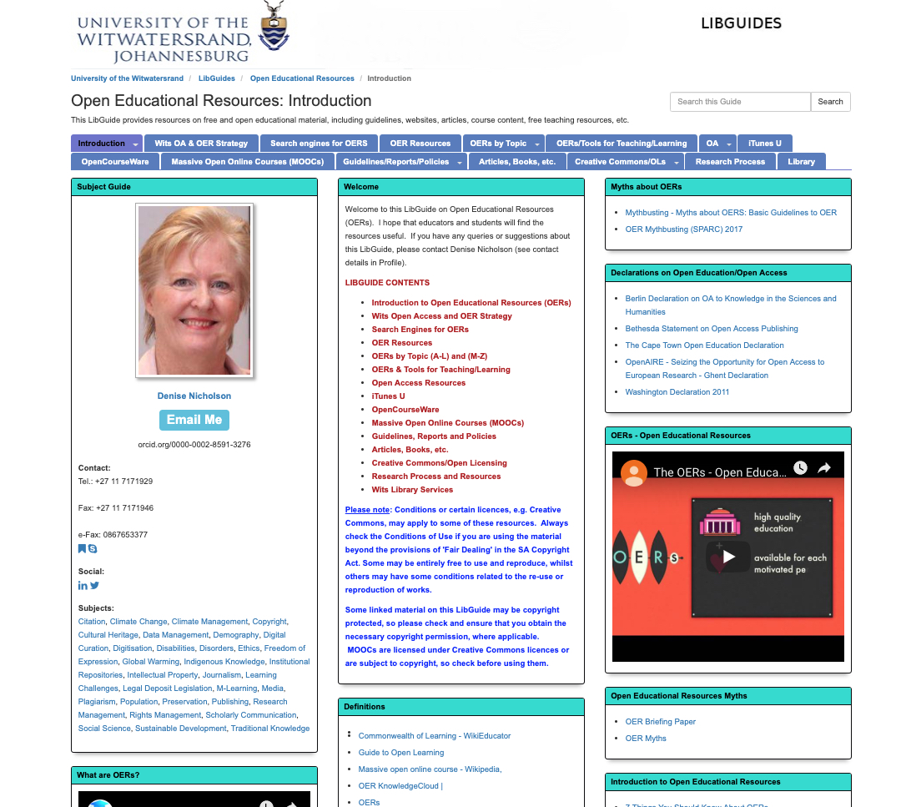
Wits OER Library Guide
You can link to this and other guides from your library website or write your own resource adapted from Wits and elsewhere.

Slide 8
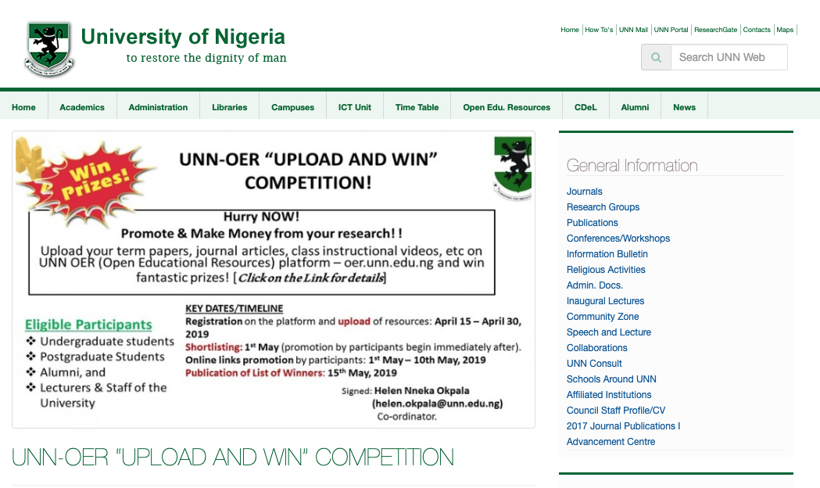
University librarians as OER/OA champions
University of Nigeria, Nsukka
Notes:
Important to note that many of the resources in the OER repository are actually OA.

Slide 9
Kwame Nkrumah University of Science and Technology library champions OER and OA
The KNUST library was a part of the team that drafted the university’s 2010 OER policy, the first in Ghana.
In 2012 Dr Helena Asamoah-Hassan was selected as the BioMed Central Open Access Advocate of the Year. KNUST became BioMed Central’s first Southern Foundation Member.
The KNUST repository now contains over 11,000 full-text resources.

Slide 10
Librarians form strategic alliances: LIBSENSE
LIBSENSE is an initiative that brings together university librarians and Africa’s NRENs in support of open access and open science.
LIBSENSE is surveying African universities on their repositories and policies.
LIBSENSE is drafting an MOU between libraries and NRENs.
LIBSENSE will identify national, regional, and international priorities; sketch out activities; and define a framework for communications and collaboration across Africa.

Slide 11
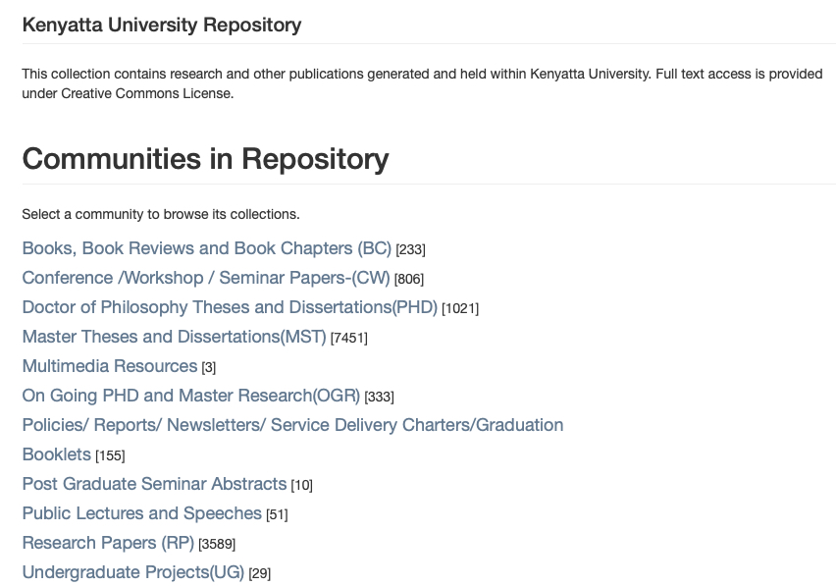
University librarians run repositories
KU institutional repository. Almost 14,000 resources, all with a CC licence. In a LIBSENSE survey of Central, East, Southern, and West Africa, 83% in East and Southern Africa and 60% in Central and West Africa wrote that their institution has an IR.
Notes:
LIBSENSE is a collaborative activity of the three African research and education networks and academic ibrarians in these countries to promote open access. LIBSENSE survey on Open Access Repositories & Librarians’ Roles. One survey for UbuntuNET and one for WACREN.

Slide 12
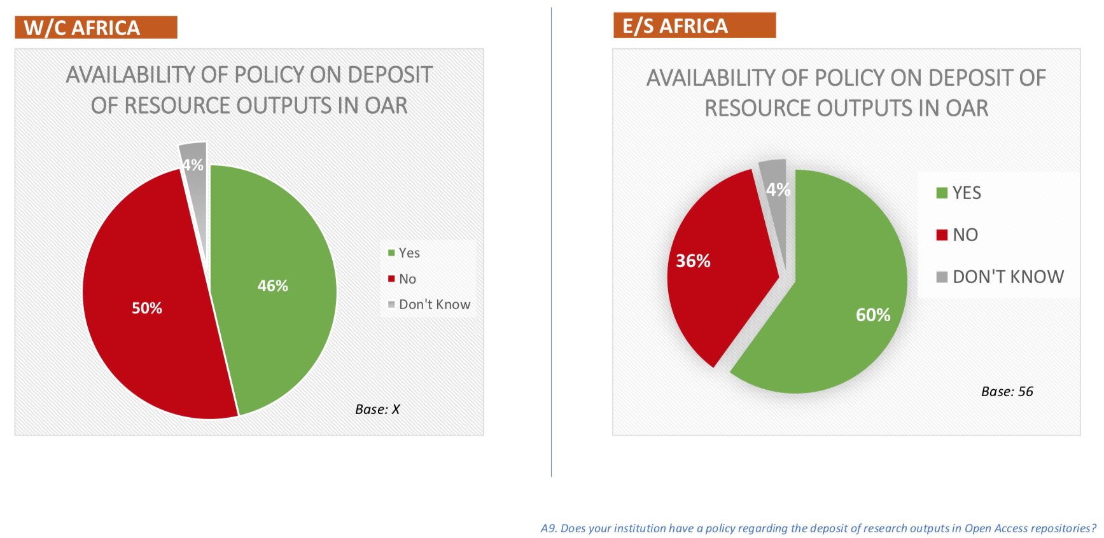
What about OER and OA policies?
From the same LIBSENSE survey. But many of these OA policies are not available online. In addition, information on OER policies is not readily available.
Notes:
Here, too, the availability of institutional policies in West and Central Africa skews to Nigeria, first, followed by Ghana.

Slide 13
Librarians working with and for children
In 2018, AfLIA won a StoryWeaver award to translate stories into African languages.
Over 200 stories have been translated into numerous African languages.
AfLIA organized translation “hackathons” to train language teams, who will train others.
Work will continue in more African countries.
Notes:
From Nkem’s SW blog: “The teams are spread across five African Countries – Ghana, Kenya, Nigeria, South Africa and Uganda. We decided to try the Hackathons so that the Master Trainers can train the others and to ensure that the translations have accurate or near-to-accurate meanings especially with languages that are tonal where one word can mean different things depending on how it is said or other words around it. Also, we noticed that some words do not have direct translations in some of the local languages. Having a Translation Hackathon enabled each language team to crowdsource solutions to such a word. Some decided to translate the word as it is pronounced locally, while some decided on compound names that explain the words. The Hackathon also drew the attention oflibrary users to the fact that new ebooks were coming in for the children.

Slide 14
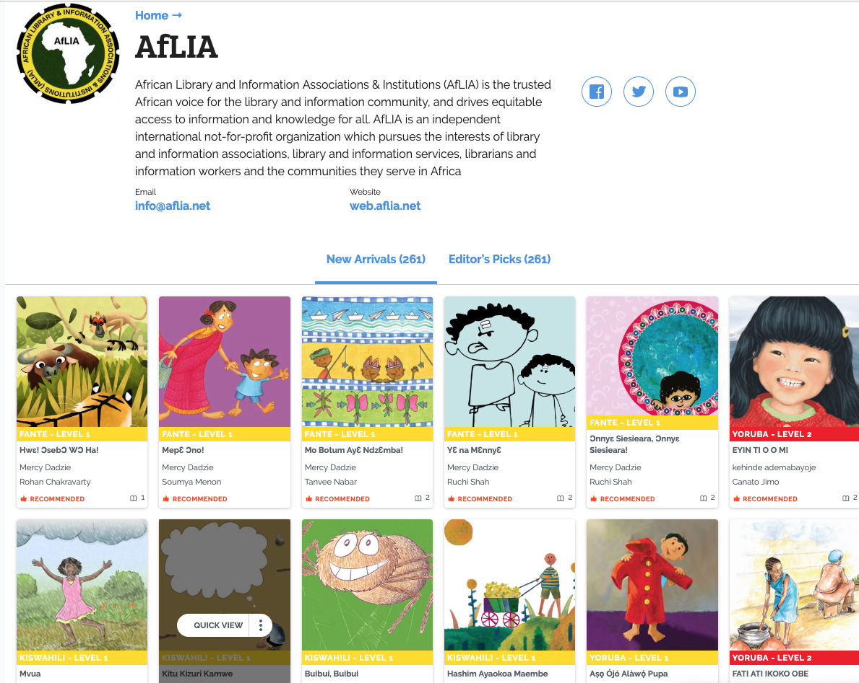
AfLIA StoryWeaver page
https://storyweaver.org.in/publishers/3186-aflia

Slide 15
Librarians and communities working together to write children’s stories
CODE Ethiopia, an NGO in Addis Ababa, works with 97 community libraries throughout Ethiopia.
CODE Ethiopia is collaborating with NBA on a project to collaborate with local librarians, teachers, and communities to develop and write openly licensed stories for young children.
Members of the community will write the stories in mother-tongue languages. The teachers, librarians, and CODE Ethiopia ensure quality control before the stories are published.

Slide 16
CODE Ethiopia, continued
This project is a continuation of one carried out with NBA in 2018. A review of this work will be found at http://www.earlyliteracynetwork.org.
Six community libraries are involved – three from last year and three new ones.
All of the stories will have a CC licence. They will be loaded on the CE community-library tablets and mounted online.
Notes:
Maybe reference the work Cornelius in Uganda?

Slide 17

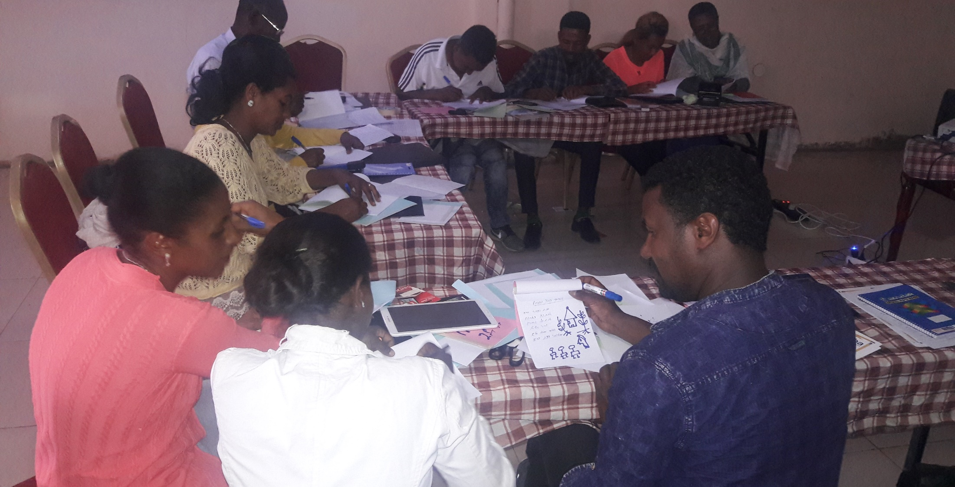
CODE Ethiopia workshop in Finote Selam
Participants included librarians, language teachers and school directors from the three new sites (Kuy, Durbetie and Finote Selam).

Slide 18
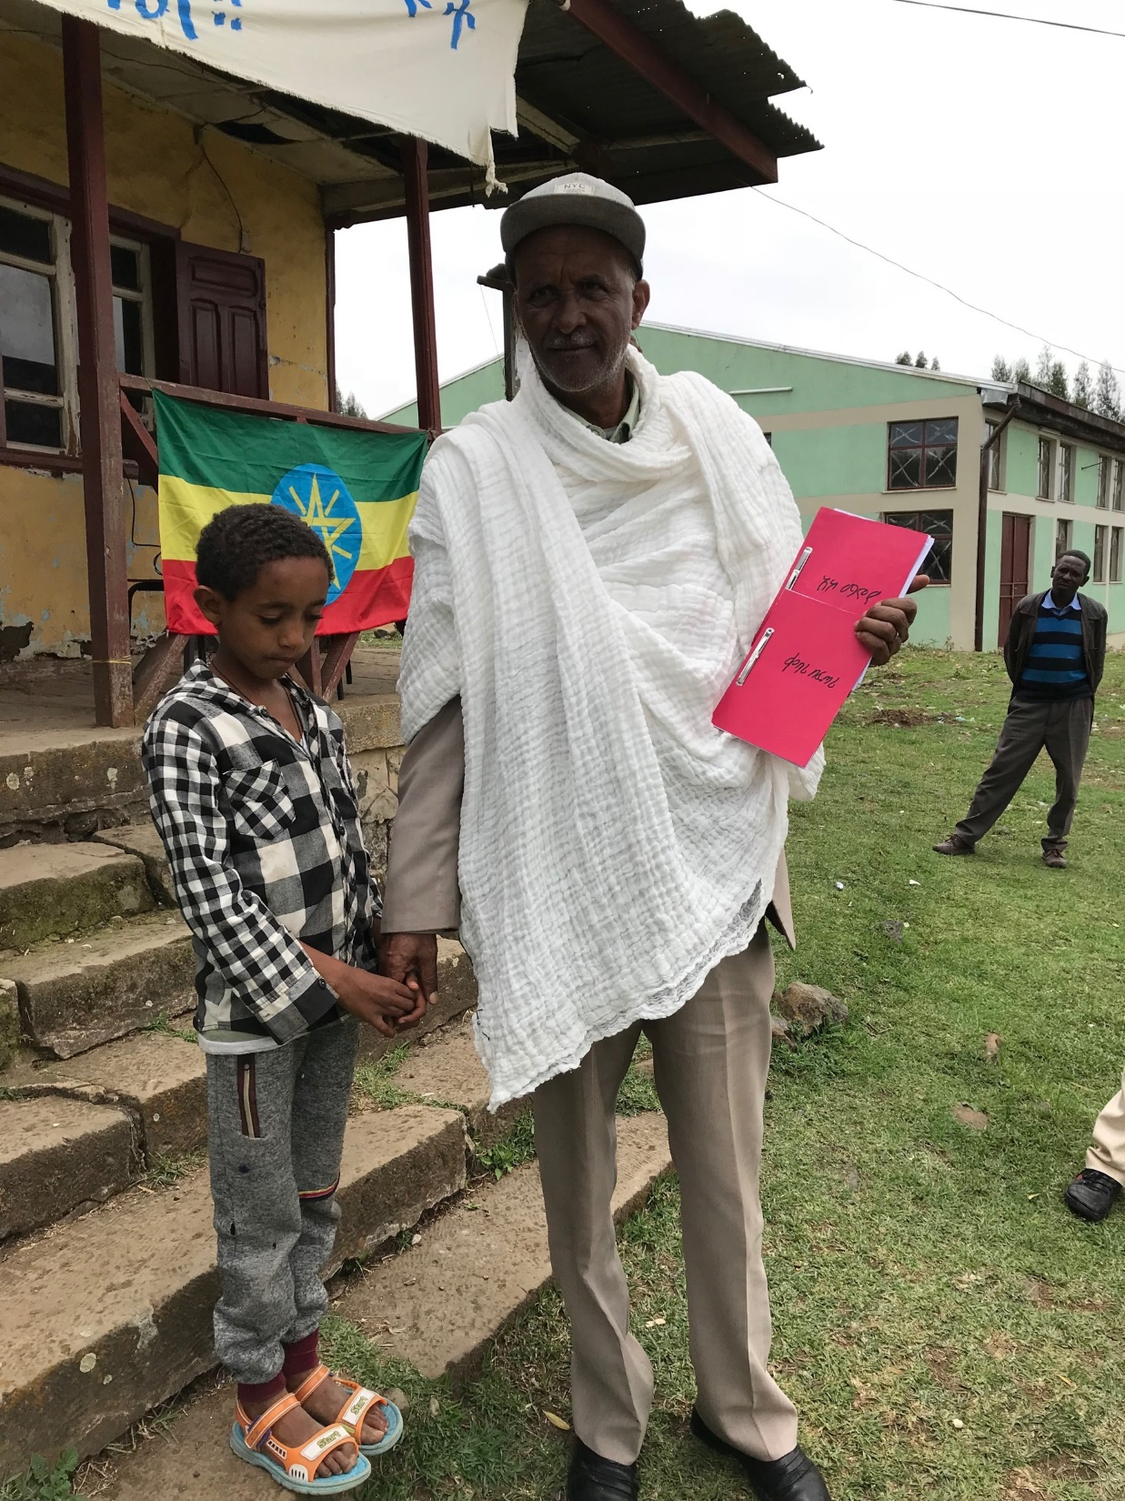
Ato Solomon and the stories he wrote
Ato Solomon is a retired English teacher and very active in the Fitche Community Library.
In this photograph in front of the library, he is shown holding two of his stories with his grandson.

Slide 19
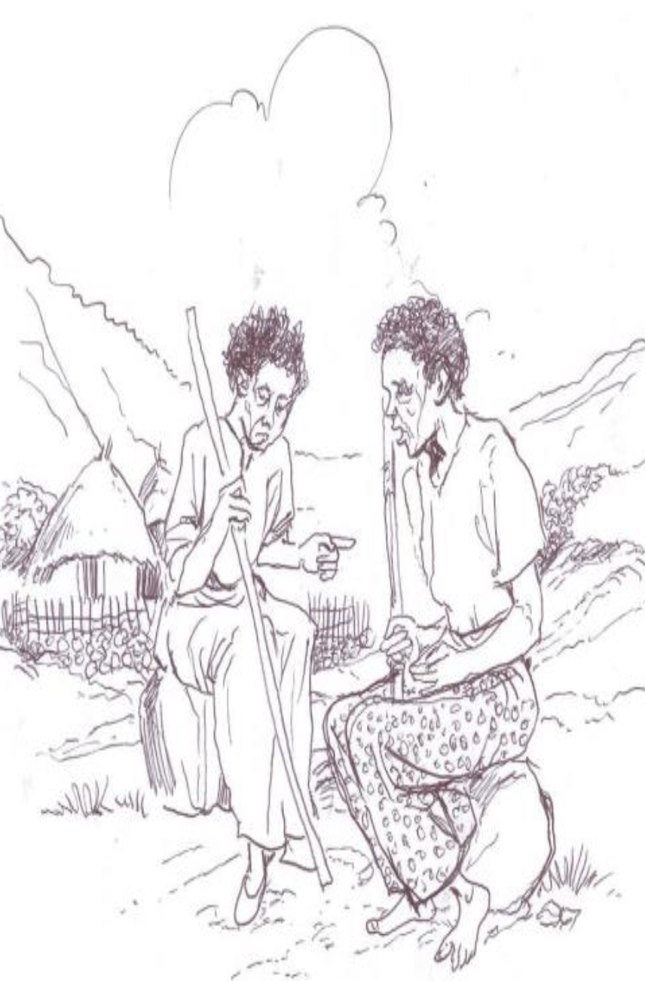
Ato Solomon’s story about two old women
Degitu and Workitu are neighbors. Degitu is poor and begs. Workitu has three sons who look after her in turn. But one son is careless and Workitu dies. The sons don’t want to admit what has happened. They take in Degitu and care for her until she dies after several years. They bury her in front of a crowd of people, who do not know the truth. The story teaches children:
Not to underestimate poor people
It is important to take care of parents
Our destiny is unknown
Notes:
This is the full story as told by Alemu: The story is about two old ladies( Degitu and Workitu) who were neghbours living in a given village. One day they met on their way and started discussing how they are getting their living. Degitu was a very old woman who is very poor and gets her living by just begging. Workitu, on the other hand , has three sons( Abebe, Kebede and Abera) and she lives in her son's house turn by turn.And she is so proud in that regard. Workitu asked Degitu who is going to burry her if shed dies? Degitu answered that it is God who will arrange the burrial and tells her that she gives it to him.
Workitu lives in a given arrangement made by her sons. When one finishes his turn he takes the mother to a near by tree and leaves her for the other son to come and take her. One day it was Abebe's turn and he forgot to take the mother from under the tree and she/Workitu was eaten by a hyena. Abebe remembered her and run to the tree but he got some ruminants like her clothes only. He run to his brothers and told the story.Then they discussed and decided to bring Degitu to their house to cover up the situation.They brought Degitu and gave all the necessary care and after several years she died and they burry her in the presence of a crowd of people.

Slide 20
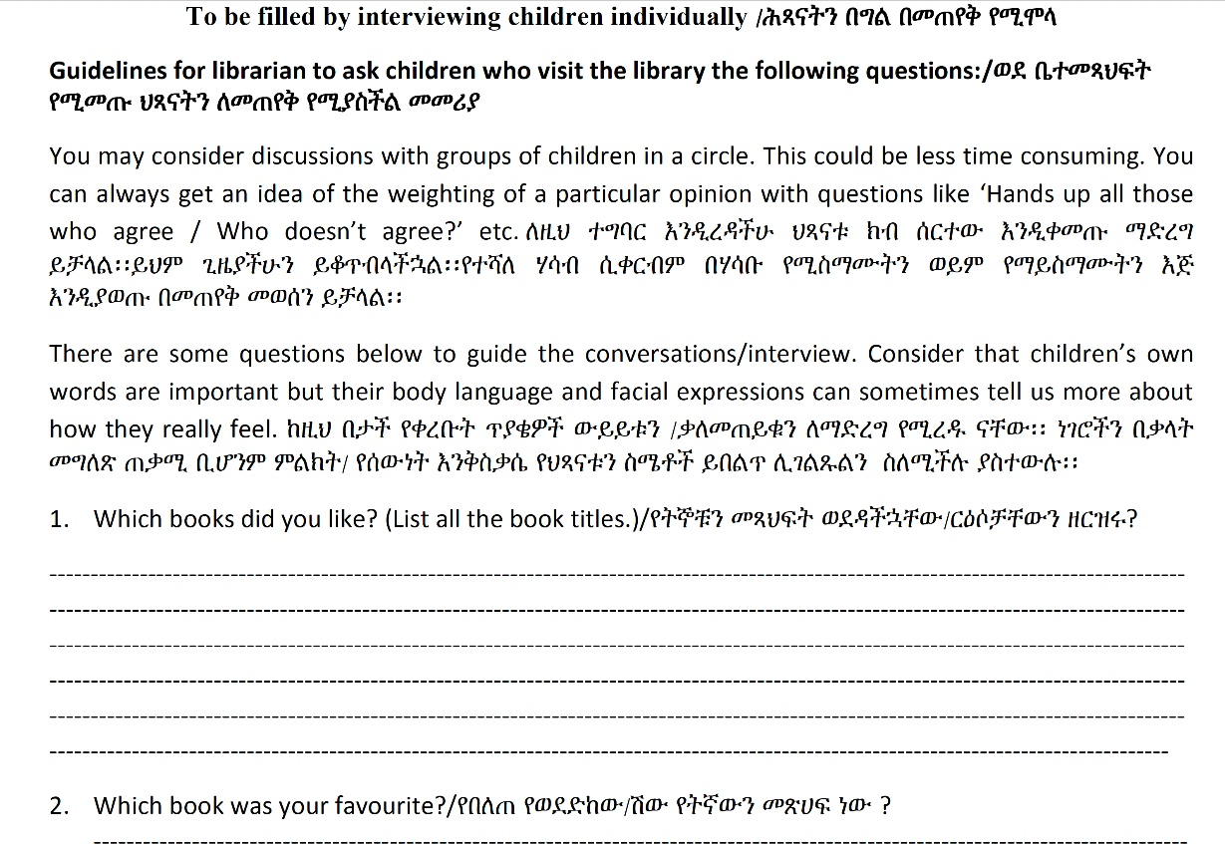
Children as evaluators
Children can tell us what they think of the stories they read.
Notes:
As an example--What do the children think about the neglectful behavior of Workitu’s sons and their deceit?

Slide 21
Watoto na Vitabu
Junior Storytellers’ Project
Watoto na Vitabu is an initiative of the Soma Book Café in Dar es Salaam.
Watoto na Vitabu has funding from NBA to work on fostering the creativity, love of reading and writing, and critical consciousness of children.
The children will write stories based on their imagination and life experiences.
They will work with trained facilitators and other experts.
Professional authors, illustrators, and editors will also be involved.

Slide 22
Watoto na Vitabu
Junior Storytellers’ Project outputs
Soma Book Café will set up a multimedia studio.
Three books will be published, using a CC licence.
One book will be adapted as an audiobook and published in print format. All three books will be mounted online. Soma will also investigate a TV tie-in.
Soma Book Café will document the entire process and publish a case study.

Slide 23
The importance of research in the Watoto na Vitabu Junior Storytellers’ Project
Documentation will focus on three components:
  The role of children as social enquirers and multimedia storytellers. The children will also become junior researchers by documenting the process from their perspective
  Key methodologies and strategies throughout the process
  All original and secondary resources, including audio and video, will be archived
Soma will develop a framework, case study, and recommendations for scale-up and replication elsewhere.

Slide 24
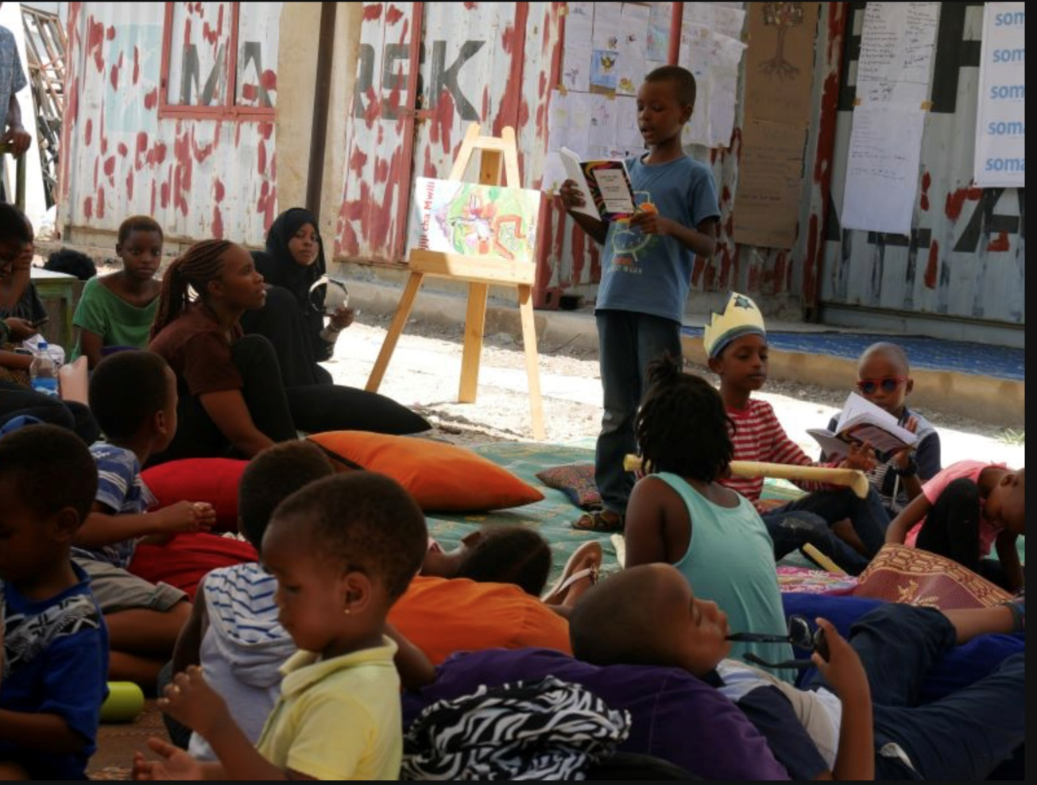
Watoto na Vitabu at Book Bazaar,
April 2019
The Watoto na Vitabu Saturday programme organizes an end of quarter fair, where children showcase their acquired reading skills and creative writing prowess. This time, the session coincided with the Book Bazaar. The children launched their own story book, Turtle and Swan and Other Stories. They also read their stories aloud to parents who attended, facilitators, and fellow children, and exhibited their work.
http://www.somabookcafe.com/watoto-na-vitabu-at-book-bazaar-april-2019/

Slide 25
Watoto na Vitabu also collaborates with librarians and libraries.
“We do not work with libraries on regular basis though we associate with and work with librarians as a key resource. On the other hand, one of our strategies is to support schools and communities to start and run user centred libraries, resource corners and community libraries. Our inputs include: mapping reading interests, facilitating a participatory book selection and sourcing books, and assisting in designing and implementing self-managed readership clubs that combine: reading, discussions, storytelling and public events. We have thus far worked with five facilities using this approach, of which only two have a trained librarian. We are in conversation with two more community resource centres which are still at nascent stages--we have mapped needs with one of the two communities.”
- Demere Kitunga, Soma Book Café
Notes:
An email to Liz Levey from Demere Kitunga, Director of Watoto na Vitabu, May 8, 2019

Slide 26
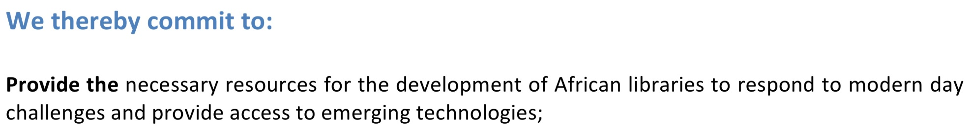
Conclusions and Thoughts from the 2015 Cape Town Declaration (quoted below)
Libraries and librarians enrich learning and culture.
They were underfunded and under-valued at every educational level in 2015; they remain so today.
There are no easy solutions.
What about strategic alliances for networking, education, and advocacy at the continental, regional, and national levels to translate declarations and goals into action?
Examples include AfLIA, IFLA, ADEA, the AAU, and librarian associations.
Question for participants: Has this presentation opened up a new line of thought for you in terms of what you do?
Notes:
Need to spell out ADEA and AAU. Everyone in the audience will know AfLIA and IFLA. Several of the sessions focus on AU and UN sustainable development goals. Also on Cape Town declaration. Question is how to translate goals and declarations into action.

Slide 27

This work is licensed under a Creative Commons
Attribution 4.0 International (CC BY 4.0) Licence https://creativecommons.org/licenses/

