Slide 1

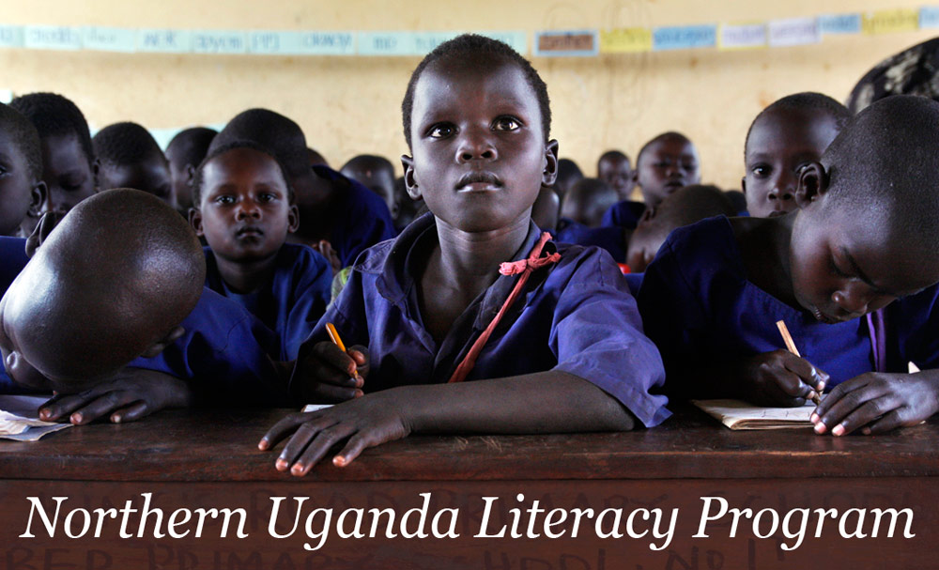
Mango Tree’s

Slide 2
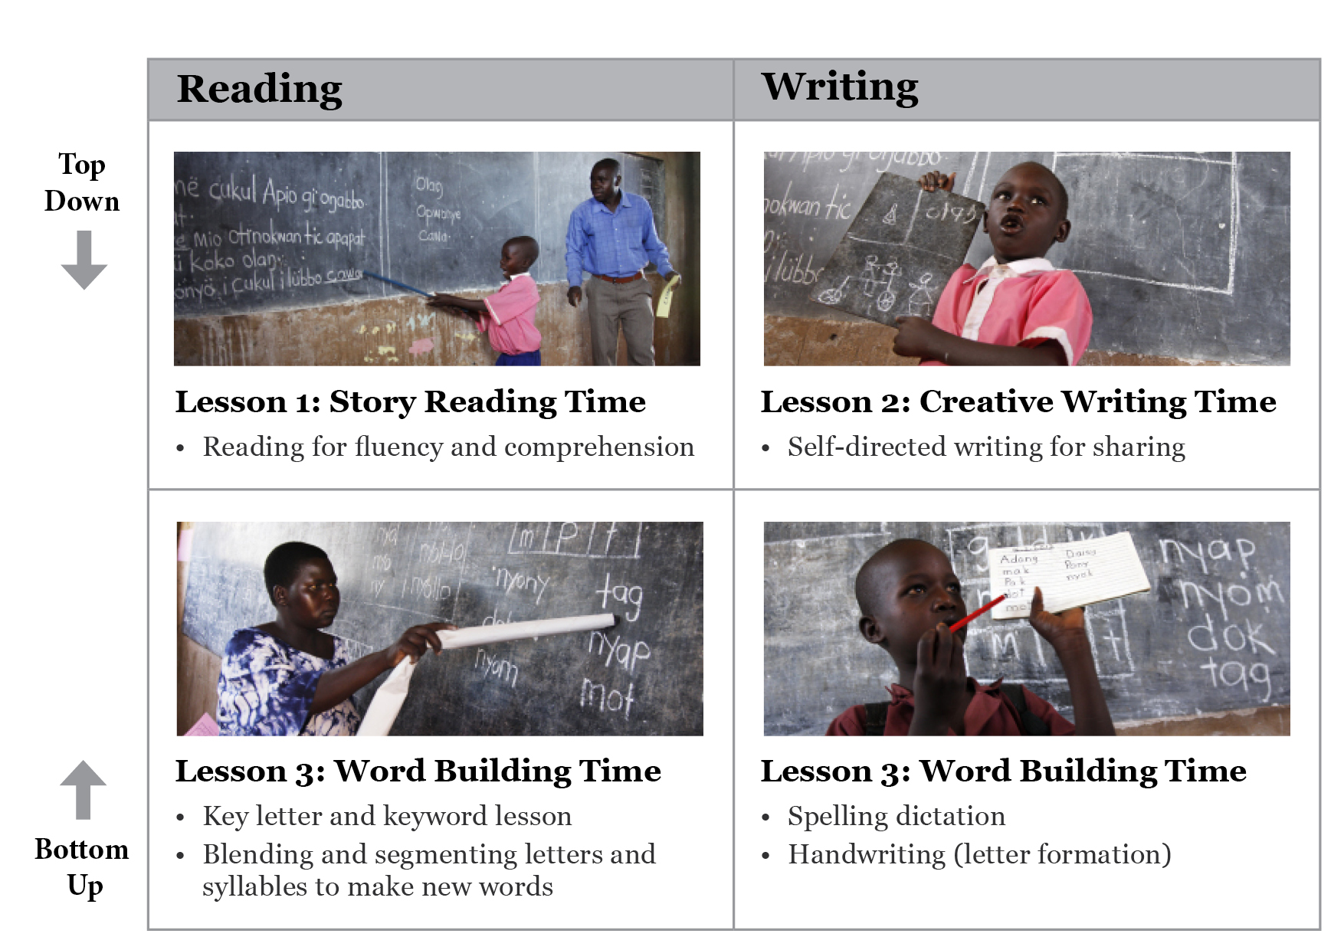
Our Model in the Classroom
Mango Tree’s Northern Uganda Literacy Program
Notes:
2

Slide 3
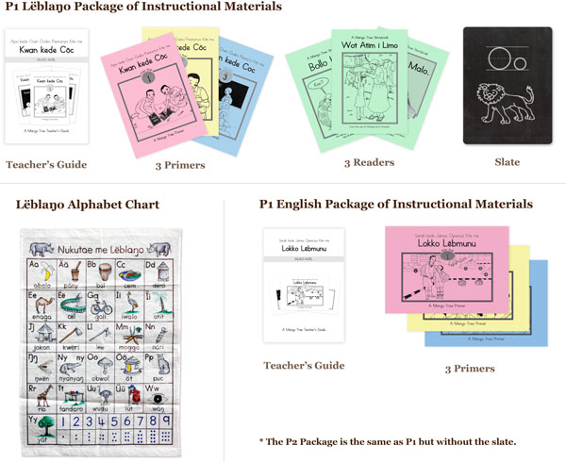
Essential Text and Non-text Materials
Mango Tree’s Northern Uganda Literacy Program
Notes:
3

Slide 4
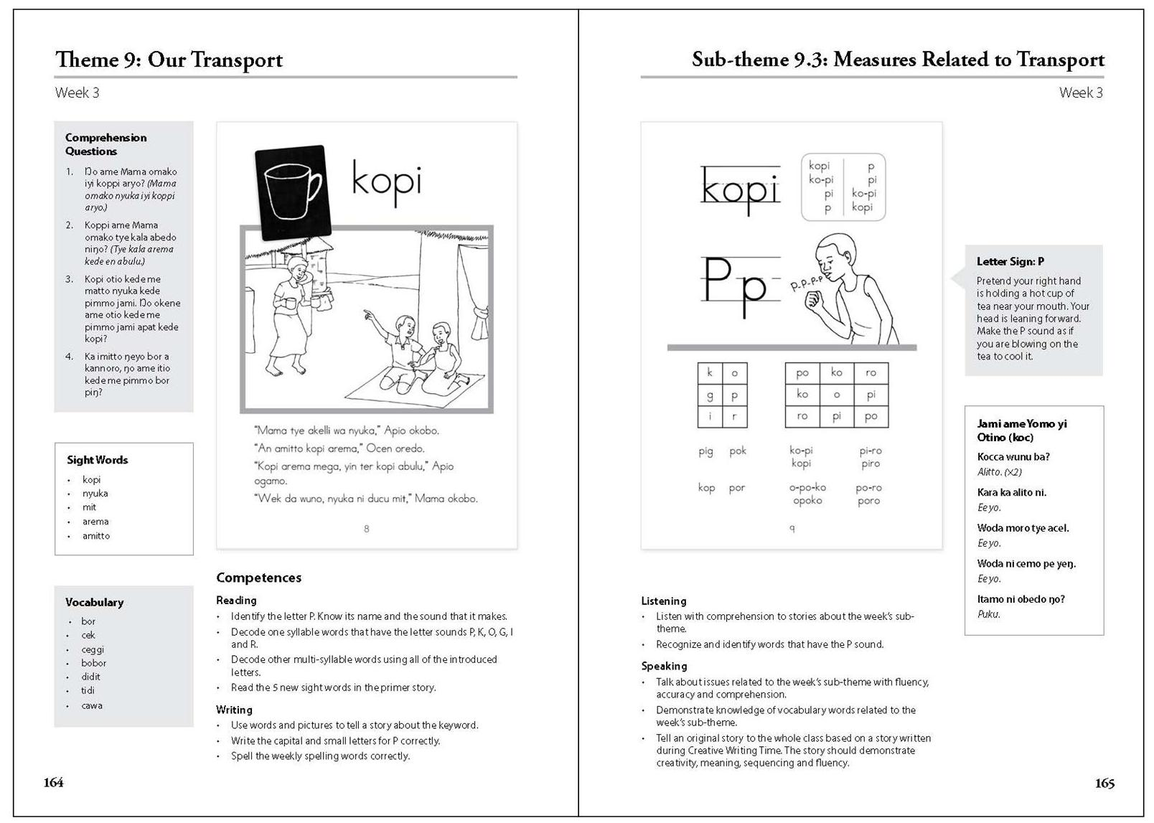
Teacher’s Guide – Sample Pages 1-2
Theme and Sub-theme for the week
Comprehension
Questions
Kinesthetic Sound Sign
Weekly Sight
Words
Song, rhyme, riddle, poem or tongue-twister
Vocabulary
Weekly Competences in Reading, Writing, Listening & Speaking

Slide 5
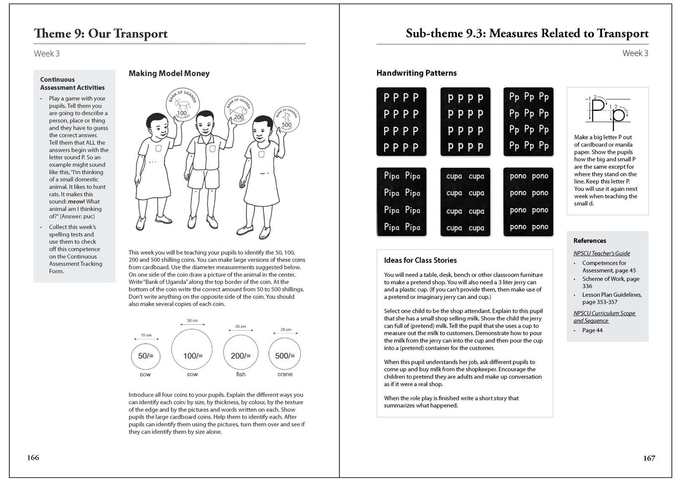
Teacher’s Guide – Sample Pages 3-4
Weekly Handwriting Patterns
Continuous
Assessment
Activities
Handwriting Tips
References to
MoES documents
Instructional
Materials
Development
Class Story Starter
Mango Tree Northern Uganda Literacy Program

Slide 6
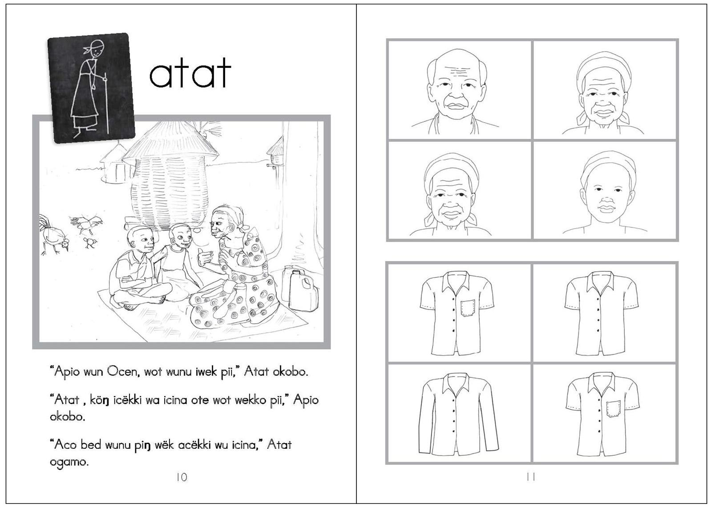
P1 Term 1 Primer – Sample Page
Mango Tree’s Northern Uganda Literacy Program
Notes:
6

Slide 7
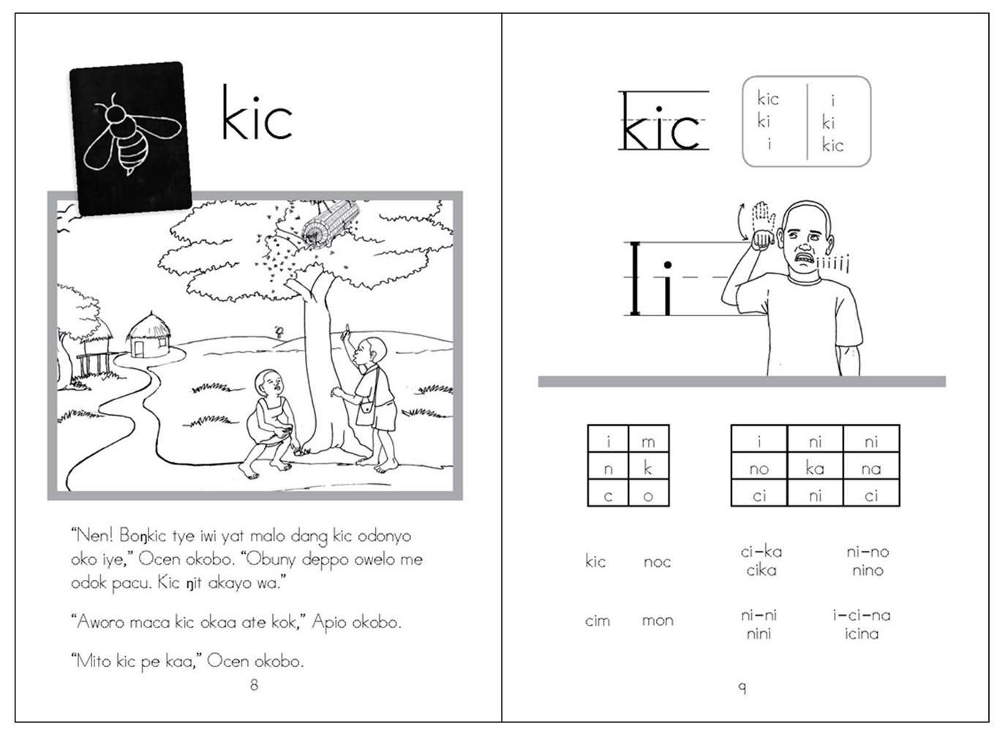
P1 Term 2 Primer – Sample Page
Mango Tree’s Northern Uganda Literacy Program
Notes:
7

Slide 8
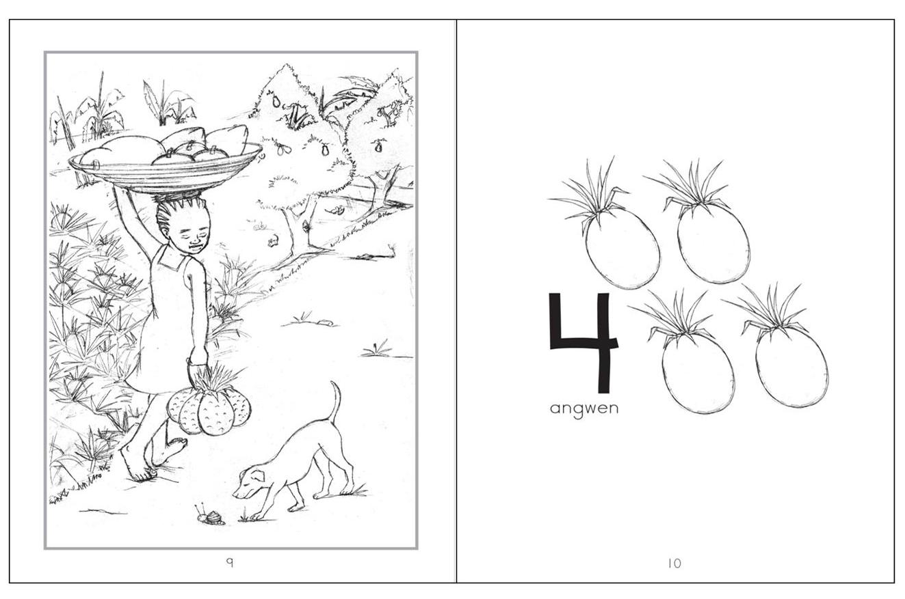
P1 Term 1 Reader: Wot Atim i Limo
Mango Tree’s Northern Uganda Literacy Program
Notes:
8

Slide 9
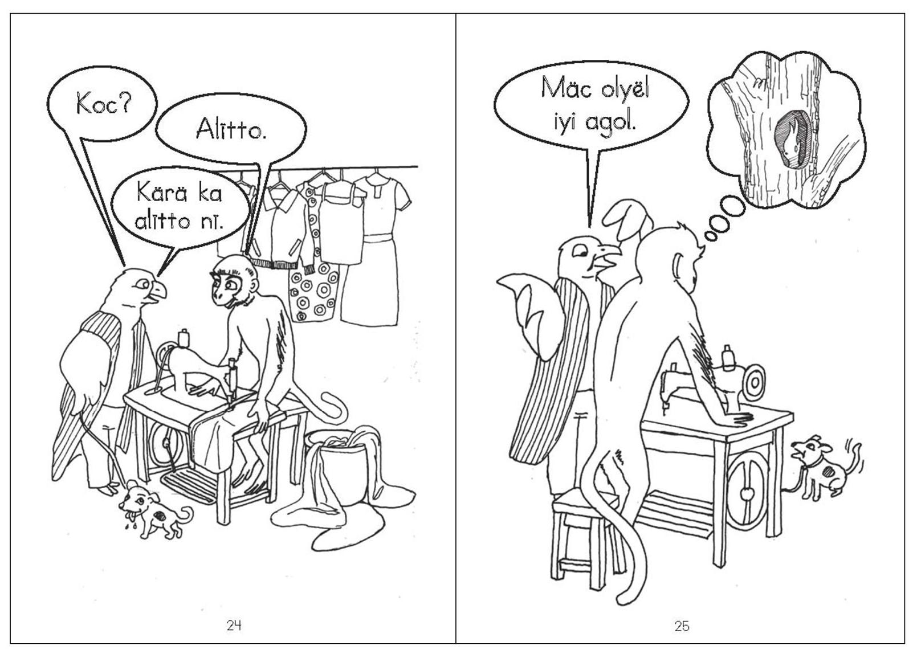
P1 Term 2 Reader: Bollo Koc!
Mango Tree’s Northern Uganda Literacy Program
Notes:
9

Slide 10
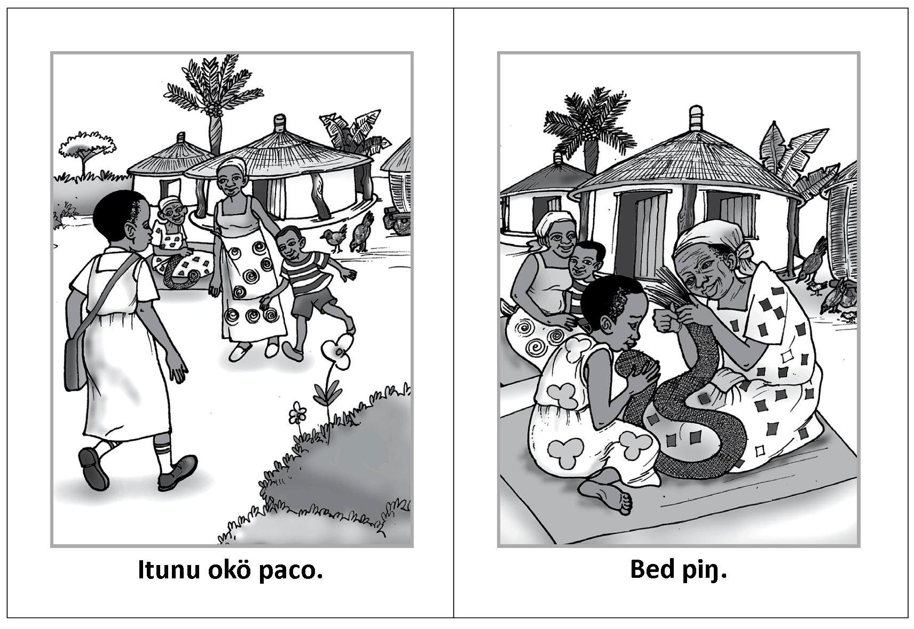
P1 Term 3 Reader: Yä Malo. Bed Pïŋ.
Mango Tree’s Northern Uganda Literacy Program
Notes:
10

